Slide 1
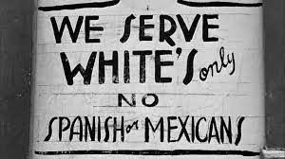
Teaching [Russian] while [Brown]
Reflections on Language Teacher and Learner Identities in the Diverse Classroom
Thomas Jesús Garza, Director
College of Liberal Arts
Texas Language Center

Slide 2
Language Teacher Identity

Slide 3
Language teacher identity (LTI)
“Language teacher identity (LTI) refers to the way language teachers see themselves and understand who they are in relation to the work they do. It is also the way others, including their colleagues and students and institutions, see them” (549).
Barkhuizen, G. (2022). “Language Teacher Identity.” In: Mohebbi, H., Coombe, C. (eds) Research Questions in Language Education and Applied Linguistics. Springer Texts in Education. Springer, Cham.

Slide 4
“Race and the identity of the nonnative esl teacher”
“I am constantly being challenged on the rules of English grammar, and it seems to me that some of my students are waiting for me to make a mistake” (581).
- “Race and the identity of the nonnative ESL teacher,” TESOL Quarterly, Autumn, 1997, Vol. 31, No. 3, Language and Identity (Autumn, 1997), pp. 580-583 .
N. Amin (1997)

Slide 5
“Theorizing Language Teacher Identity: 3 perspectives and beyond”
“In order to understand language teaching and learning we need to understand teachers; and in order to understand teachers, we need to have a clearer sense of who they are: the professional, cultural, political, and individual identities which they claim or which are assigned to them” (p. 22).
JOURNAL OF LANGUAGE, IDENTITY, AND EDUCATION, 4(1), 21–44
M. Varghese, b. morgan, b. Johnston, & K. Johnson (2005)

Slide 6
“Online Teacher Identity”
F. Hafsa & R. Borasi (2019)
Center for Learning in the Digital Age (LiDA)
Transforming Education by Leveraging Digital Technologies

Slide 7
“Language Teacher Identity”
(C) Kinds of Language Teacher Identities
C1 Narrated identities: Identities defined in narrative contexts
C2 Identities-in-practice: Identities defined via teaching practices C3 Gendered identities: The role of gender and sexual orientation in teacher identity development
C4 Future selves: How teachers perceive themselves in the future
C5 Sociocultural identities: Teacher identities with a particular focus on the link between language and culture
“Language Teacher Identity,” Language Teaching (2019), 52, 281–295.
H. Kayi-AYDAR (2019)

Slide 8
Language Teacher Educator Identity
Gary Barkhuizen (2021)
Published online by Cambridge University Press: 17 February 2021

Slide 9
Language learner Identity

Slide 10
Profiles of learners in Language Courses
THEN
NOW

Slide 11
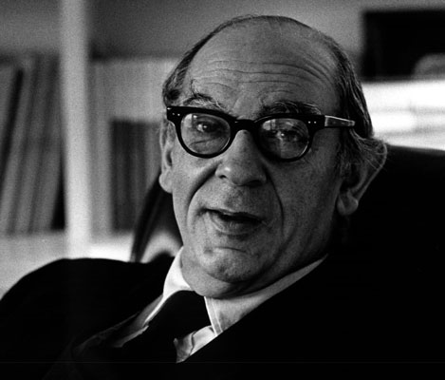
Isaiah Berlin: On Hedgehogs and Foxes
1909-1997
1953

Slide 12
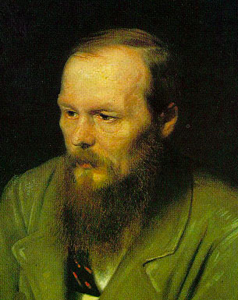
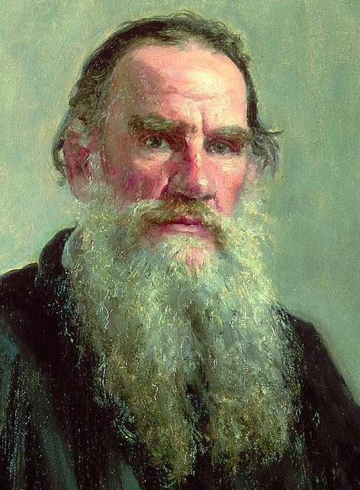
Berlin’s Dichotomy
FOXES draw on a variety of experiences and for whom the world cannot be reduced to a single idea
Dostoevsky
Plato
Dante
Proust
Nietzsche
Ibsen
HEDGEHOGS view the world through the lens of a single defining idea
Tolstoy
Aristotle
Shakespeare
Erasmus
Goethe
Joyce

Slide 13
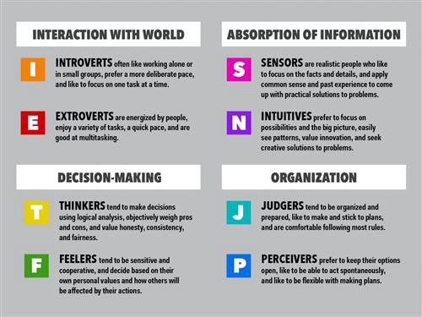
Myers-Briggs type indicator
1956

Slide 15
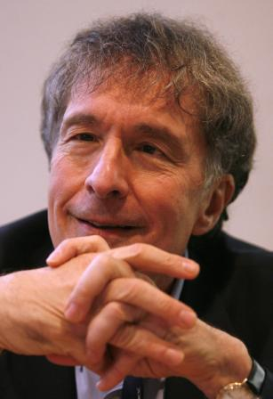
Howard Gardner’s Multiple Intelligences and the Learner
1943- .
1983

Slide 16
Frames of Mind : Multiple Intelligences
In the heyday of the psychometric and behaviorist eras, it was generally believed that intelligence was a single entity that was inherited; and that human beings - initially a blank slate - could be trained to learn anything, provided that it was presented in an appropriate way. Nowadays an increasing number of researchers believe precisely the opposite; that there exists a multitude of intelligences, quite independent of each other; that each intelligence has its own strengths and constraints; that the mind is far from unencumbered at birth; and that it is unexpectedly difficult to teach things that go against early ‘naïve' theories of that challenge the natural lines of force within an intelligence and its matching domains.
(Gardner 1983: xxiii)

Slide 18
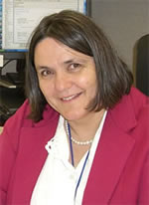
Betty Lou Leaver: Teaching Everyone
1950- .
1998

Slide 19
Teaching the Whole Class
Whole-class teaching is not another method; it is not another syllabus design. Whole-class teaching is a philosophy that puts responsibility for learning back into the students’ hands and responsibility for the classroom back into the teachers’ hands, from whence contemporary approaches have wrenched both. [It] subordinates method and definition of appropriate outcomes to students’ specific learning needs realized within a group setting in order to improve outcomes dramatically – not on tests alone, but in actual learning achieved and the ability and motivation to continue learning on a lifelong basis. (Leaver 1998: vii)

Slide 20
Leaver’s Categories
Environmental preferences
Group vs. Individual Work
Vibrant vs. Quiet Environment
Sensory modalities
Reading out loud vs. Being read to
Verbal vs. Visual stimulation
Personality types
Hands off vs. Hands on
Individual vs. Group work
Cognitive styles
Global vs. Specific
Rules first vs. Text first

Slide 21
“It’s all about hybridity, ¿tú sabes ?” Jesse, in Come and Take it Day (2001)

Slide 22
Intersectional Learner identities
GENder
RACE / ETHNICITY
SEXUALITY
Male
Female
Non-Binary
White
Non-White
Non-Majority
Heteronormative
Non-Heteronormative
LGBTQIA+

Slide 23
Intersectional Learner identities
Economic positionality
Family setting
Educational context
± Wealth
Class
± Power
”Nuclear” family
Single parent
Non-”traditional”
Educational History
“1st gen”
Access to education

Slide 24
Hegemony and Available L2/c2 texts
• Majority Culture
• Patriarchal
• Gender Binary
• Heteronormative
• Economically Empowered
• Educationally privileged

Slide 25
¡Avancemos!
Holt McDougal, 2018

Slide 26
Français interactif
University of Texas, 2021

Slide 27
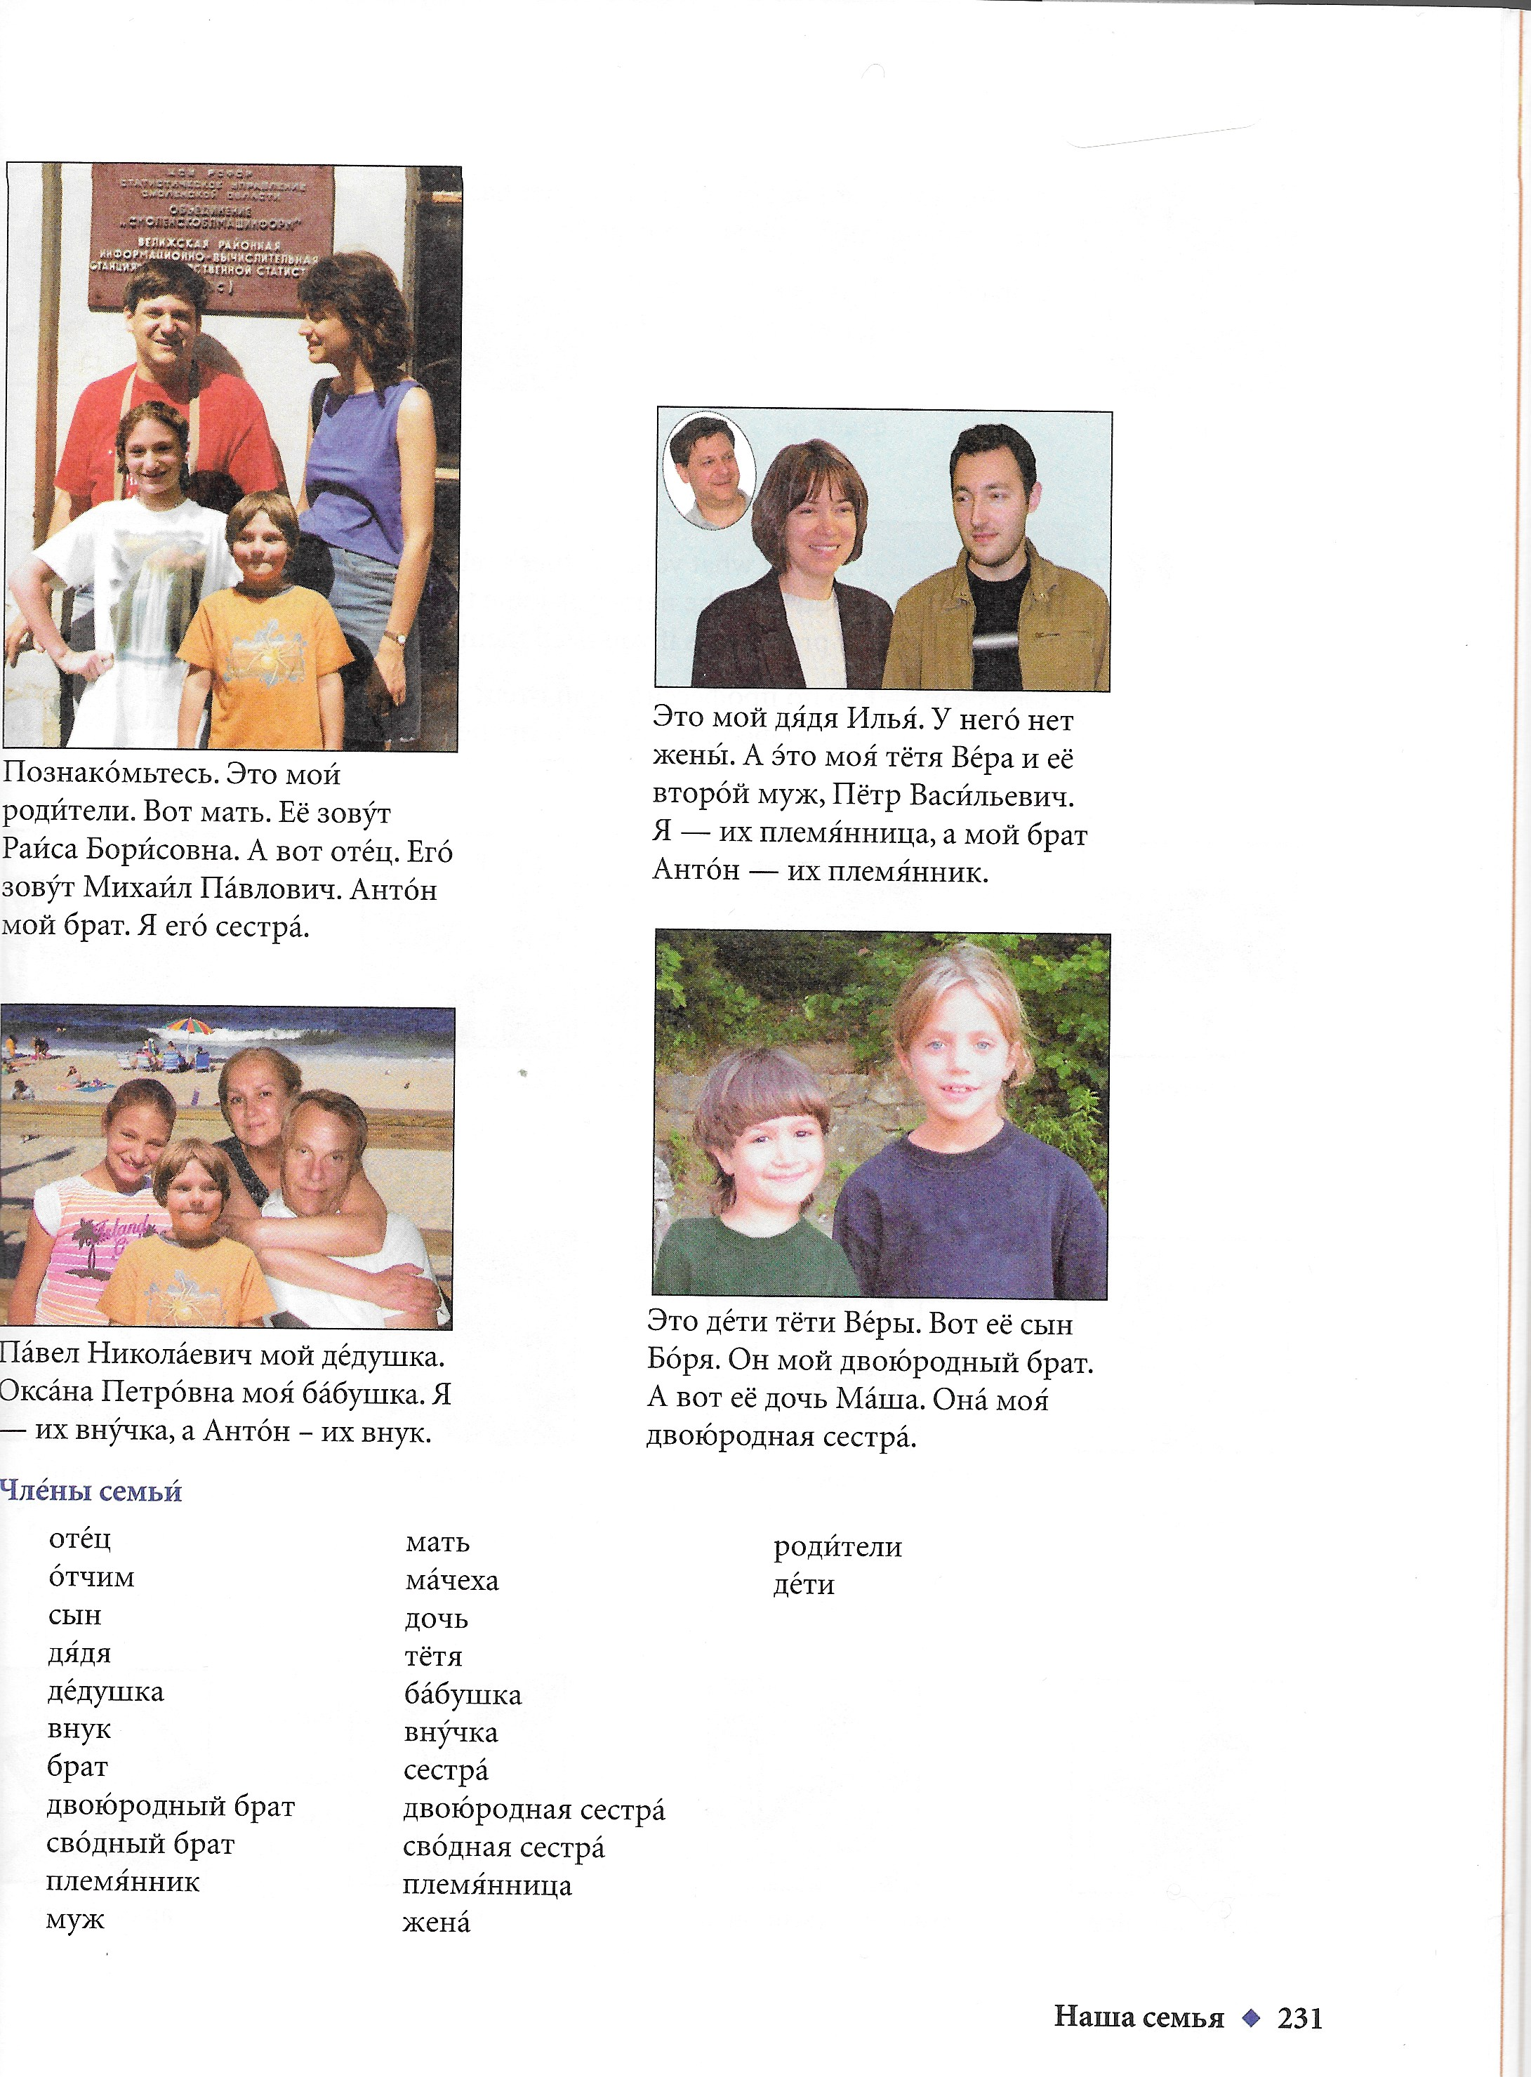
Голоса 5th ed.
Pearson, 2012

Slide 28
Considerations for Equity and Social Justice in Language & Culture Courses
_{Syllabus}
_{“Textbook”}
_{Identity Intersectionality}
_{Gender}
_{Race/Ethnicity}
_{Sexual Orientation}
_{Educational Access}
_{Family Setting}
_{Method(s)}
_{Interaction}

Slide 29
“There is no hierarchy of oppressions”
Audre Lorde
From Homophobia and Education, 1983. (New York: Council on Interracial Books for Children)

Slide 30
Thank you!
Questions?
Comments?
Discussion?
Thomas Jesús Garza
tjgarza@austin.utexas.edu
512-825-3287

