Slide 1
LEARNING ASSISTANT ORIENTATION

Slide 2
LEARNING ASSISTANTS | ABOUT
Dr. Ostlund

Slide 3
WHO ARE THE LAs?
The best and the brightest students who took course in previous semesters are selected as LAs
Students who understand the content of the courses
Students who interacted well with instructors, LAs, and other students
Focus on student ideas and facilitate group discussion and conceptual understanding

Slide 4
WHAT DID YOUR LAs DO THAT WAS EFFECTIVE TO ENHANCE YOUR LEARNING?

Slide 5
WHAT DID YOUR LAs DO THAT WAS NOT EFFECTIVE?

Slide 6
WHAT ARE SOME THINGS YOU WISHED YOUR LAs HAD DONE TO ENHANCE YOUR LEARNING?

Slide 7
HANDS ON SCIENCE | ABOUT
Dr. Ostlund

Slide 8
CURRICULUM
Energy in electrical circuits
Geologic time
Energy in particles: temperature and sound
Earth’s plate tectonics
Energy, forces, and motion
Energy in the Earth: conduction & convection
Energy
and
Matter
Energy in life: photosynthesis and respiration
Energy and forces in space
Structures of life
Energy transfer in seasons
Heredity and evolution
Energy transfer in weather & climate

Slide 9
INTEGRATED CURRICULUM SAMPLE
Semester One
Semester Two
Semester Three
1
Small Particle Model
2
The Elements
4
Chemical Bonds and Reactions
Contact and Non-contact Interactions
2
Non-contact Electrostatic Interactions
1
5
4
Chemical Potential Energy
Photosynthesis
1
6
Energy Transfer and Forms of Energy
Electrostatic Potential Energy
3
Magnetic Potential Energy
3
Radiant Energy
Four semester sequence grouped as:
(1) Physics (2) Chemistry & Geology (3) Biology (4) Astronomy & Climate

Slide 10
LEARNING CYCLE
Initial Ideas
Collecting and Analyzing Data
Summarizing Questions

Slide 11
YOUR IMPORTANCE
Essential to the Hands-on-Science Program
Improves the learning of ALL students – students in classes & LAs
Provides person-power needed to use interactive engagement & student-centered instruction

Slide 12
YOUR RESPONSIBILITIES AS AN LA
Work directly with students to make courses more student-centered using interactive teaching/learning techniques
Take pedagogy seminar on interactive teaching techniques (offered in the Fall and Spring)
Meet weekly with the course instructor to provide feedback & prepare for upcoming activities

Slide 13
LA HANDBOOK
LA Handbook – almost everything you need to know about your role as an LA
You will be expected to be familiar with its contents for the first Pedagogy class.

Slide 14
RESPONSIBILITIES | IN CLASS
Dr. Dunn

Slide 15
EXPECTATIONS
Be fully present
Engage with the students by not being sidetracked with other tasks
Actively moving around the room
Keep homework for other classes out of sight

Slide 16
DURING THE ACTIVITY
Initial Ideas
ask questions to see what students’ initial ideas are about topics
check for misconceptions
taking attendance (unless otherwise said by instructor)

Slide 17
DURING THE ACTIVITY
Exploration
Constantly moving
Not sitting at LA table
Asking questions for further thinking
Helping with equipment issues/malfunction

Slide 18
DURING THE ACTIVITY
Summarizing Questions
check for understanding
make sure they have completed the questions
if completed the questions, ask what the main idea was for the day, ask more questions, or give them something to do to further the activity
if reprep of equipment needs to happen and it is nearing end of class, you can start during this time

Slide 19
RESPONSIBILITIES | OUTSIDE CLASS
Dr. Marinova

Slide 20
EMAIL COMMUNICATION
It is important that you communicate with your Instructor/Lead LAs/supervisor in a timely manner. Please make sure you do the following on a regular basis throughout the semester:
Check your email at least once each day.
Most likely, an e-mail from your instructor requires a response, or at least a quick note that you received the information included in the e-mail.
If the e-mail is addressed to more than just you, make sure that you reply to all so that your fellow LA’s are aware of arrangements being made.
If you have a time-sensitive need for information from your instructor/Lead LA/peers that is work related, then call or text your instructor (ex: questions about grading that you need to know so that grading can proceed, for example). It’s OK if this is during the weekend.
If your instructor/Lead LA/peers do not need to know something immediately, then send them an email.

Slide 21
PREPPING FOR TTM’S
You must absolutely come prepared to every teaching team meeting.
Paid for 0.5 hr for prep – Expected to use this time wisely and efficiently
Being prepared for the meeting creates a more efficient way of spending our meeting time.
If you have not read the labs for that week, thought about it, and know the big idea of those lessons, then you are not prepared for the meeting.
These meetings are devoted to clearing up any content confusion, ensuring that equipment needs are met, and identifying where students are going to have the most problems (and how to resolve them).
They may also be used to discuss problem areas or concerns with students specific to that class (general student interactions will be discussed in the pedagogy class).
These meetings can only be productive if you come prepared.
It’s OK if you don’t know the answers to all the questions – just be fully involved during the meetings so that your instructor can help you get ready for class!

Slide 22
RESPONSIBILITIES | GRADING
Dr. Marinova

Slide 23
GRADING
Every semester all or some of the following issues come up with grading:
misplaced quizzes
inconsistent grading
unclear markups of student quizzes
mistakes in the addition of total points
mistakes when those scores were entered into Canvas.
Please refer to grading guideline sheet in order to anticipate and avoid these problems!

Slide 24
EXPECTATIONS | FROM YOUR LEAD LA’S

Slide 25
COMMUNICATION
Know who to contact for
Inventory, issues: Lead LAs, Rachel
timesheets: Rachel
absences: Lead LAs, Rachel, Co-LA, professor
If you’ll be absent from class last minute…
text Co immediately so they are informed
email necessary people
Respond to all emails PROMPTLY (aka within 24 hours)
Notes:
Madeline

Slide 26
PROMPTNESS
“Early is on time, on time is late, and late is unacceptable”
CLASS
TTM’s
Weekly Reports (9 pm on Sunday’s)
Notes:
Adrielle

Slide 27
DRESS CODE
Wear your name tag at all times
No inappropriate clothes
no shorts or short skirts
no leggings/ yoga pants (unless fully covered..)
no low cut/ sheer shirts
If it’s questionable, it’s probably not good..
Notes:
Madeline

Slide 28
TALK TO YOUR CO…
On your own time, communicate with your Co
est. class roles (i.e. binder attendance vs. canvas attendance, checking HW, entering HW grades, etc.)
exchange contact info
Notes:
Adrielle

Slide 29
CONTACT INFO
Madeline Allen | 972.849.9444 | madeline.allen720@gmail.com
Adrielle Chew |713.826.2099 | adriellechew@gmail.com
Rachel Ray | 254.760.9588 | ray@uteach.utexas.edu
Antonia Chimonidou | 512.963.9403 | antonia.chimonidou@utexas.edu
Karen Ostlund | ostlund@uteach.utexas.edu
Irina Marinova | 512.669.2903 | irina.marinova@gmail.com
Dennis Dunn | dennispdunn@yahoo.com
Notes:
Madeline

Slide 30
WEEKLY REPORTS
Communicates what happens in class to the Lead LAs
Addresses any issues
Record keeping for your hours
Due Sundays at 9pm
Notes:
adrielle

Slide 31
RESPONSIBILITIES | CANVAS
Lead LAs

Slide 32
ADMINISTRATIVE TASKS
Be sure to take attendance every class, and take notes on a case by case basis in the comments section.
Be sure to update HW everyday an assignment is due.
Input quiz grades and “mute assignment” as soon as you are done grading the quizzes.
Make sure that you keep a hard copy of attendance, grades, etc., with dates so that you can double check your Canvas entries in case a student has questions.
You may need to post announcements or send e-mails to all or to individual students so be sure to familiarize yourself with how this is done on Canvas.
Notes:
Madeline

Slide 33
INPUTTING GRADES
Make sure that each assignment is in the correct group on Canvas.
Unless the assignments are already pre-labeled in Canvas, you need to properly label assignments/homework/quizzes/etc. as well as due dates in the gradebook.
For example: Chapter 2 Activity 2 HW 1 assigned in M
Bad Label: Homework 5
Good Label: HW5 - Ch 2 Act 2 HW 1
Assign a due date for every assignment
All quizzes should weigh the same in order for Canvas to drop the lowest grade. Make sure that you convert points to percentages before you input the grades for a quiz. For example, if a quiz is out of 50 and a student gets 45/50, you should input 90/100 on Canvas.
If a student misses an assignment, do not leave that entry blank. Instead, insert a zero for all missed assignments.
When uploading quiz grades, make sure you “mute assignment” unless your instructor tells you otherwise.
Notes:
Adrielle

Slide 34
ATTENDANCE
When recording attendance, record ALL absences (whether excused or unexcused) and include any relevant notes if a student sent an e-mail about their absence or gave you an excused note.
Mark an “A” for students who are absent and “T” for those who are tardy in the respective date column.
Any documentation for absences given to you should be given to your instructor immediately (i.e. forward any emails, doctor’s notes, etc. or give paper copies)
Any emails regarding a student’s attendance should be copied to the instructor to handle the matter.
Notes:
Madeline

Slide 35
ADMINISTRATIVE | MY ROLE
Rachel Ray

Slide 36
WHAT RACHEL DOES
Approve timesheets
Disciplinary issues/ concerns
Equipment
Email me about broken items
Let me know if we are missing anything

Slide 37
STIPULATIONS
You must be enrolled in 12 hours of classes throughout the semester.
You must have a GPA of at least 2.0 or higher.
You cannot work past 20 hours in a week.
You cannot teach the classes, give quizzes or exams without the instructor present, or do clerical work that is not about record-keeping for a class.

Slide 38
ADMINISTRATIVE | BROKEN ITEMS
Rachel Ray

Slide 39
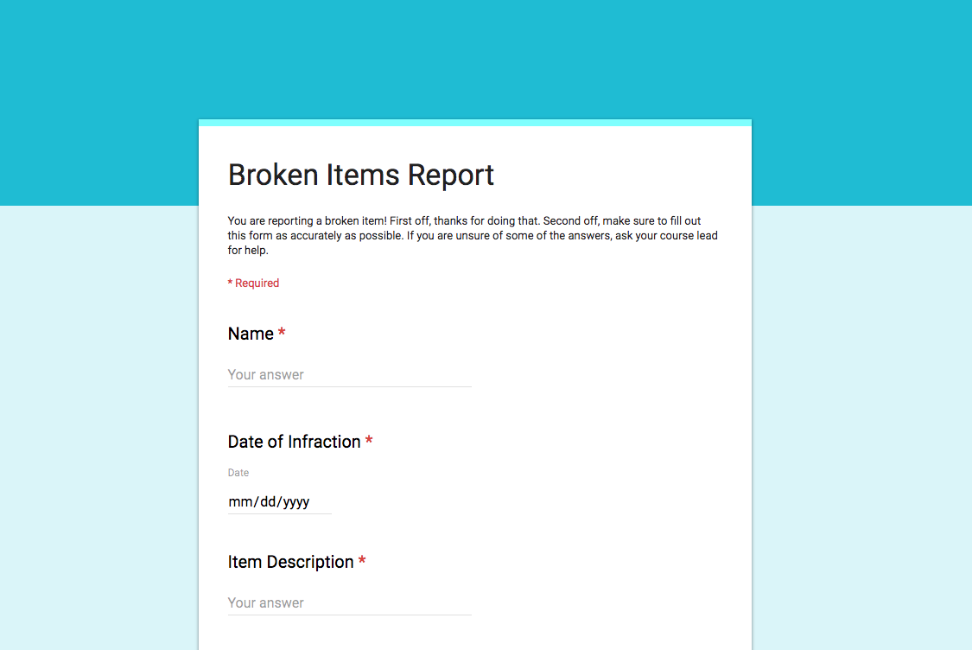
NEW GOOGLE FORM!!
Fill out form
Put in “Broken Items Bin”
Email/text/groupme your course lead

Slide 40
ADMINISTRATIVE | TIMESHEETS
Rachel Ray

Slide 41
PAY PERIODS
1st – 15th
16th – end of the month
Sheet in folder tells you when these are due and when you will get paid. Write them down now.

Slide 42
YOUR HOURS
5 hrs class + 1 hr TTM + 1 hr Pedagogy + 0.5 hr Prep for TTM + Possible Grading Hours
Please do not work more than 8 hours in a day. If you happen to do that, can be paid for it, but should be rare.
Max hours per week (set by UT):
20 hours a week

Slide 43
FILLING OUT A TIMESHEET
Time increments:
Record in 15 minute increments.
15 minutes = 0.25 hour
For example, if you worked 2 hours and 45 minutes, you would record 2.75 hours.
Round up your numbers.
For example, if you worked 2 hours and 20 minutes, put 2.5 hours- use your best judgment in general.

Slide 44
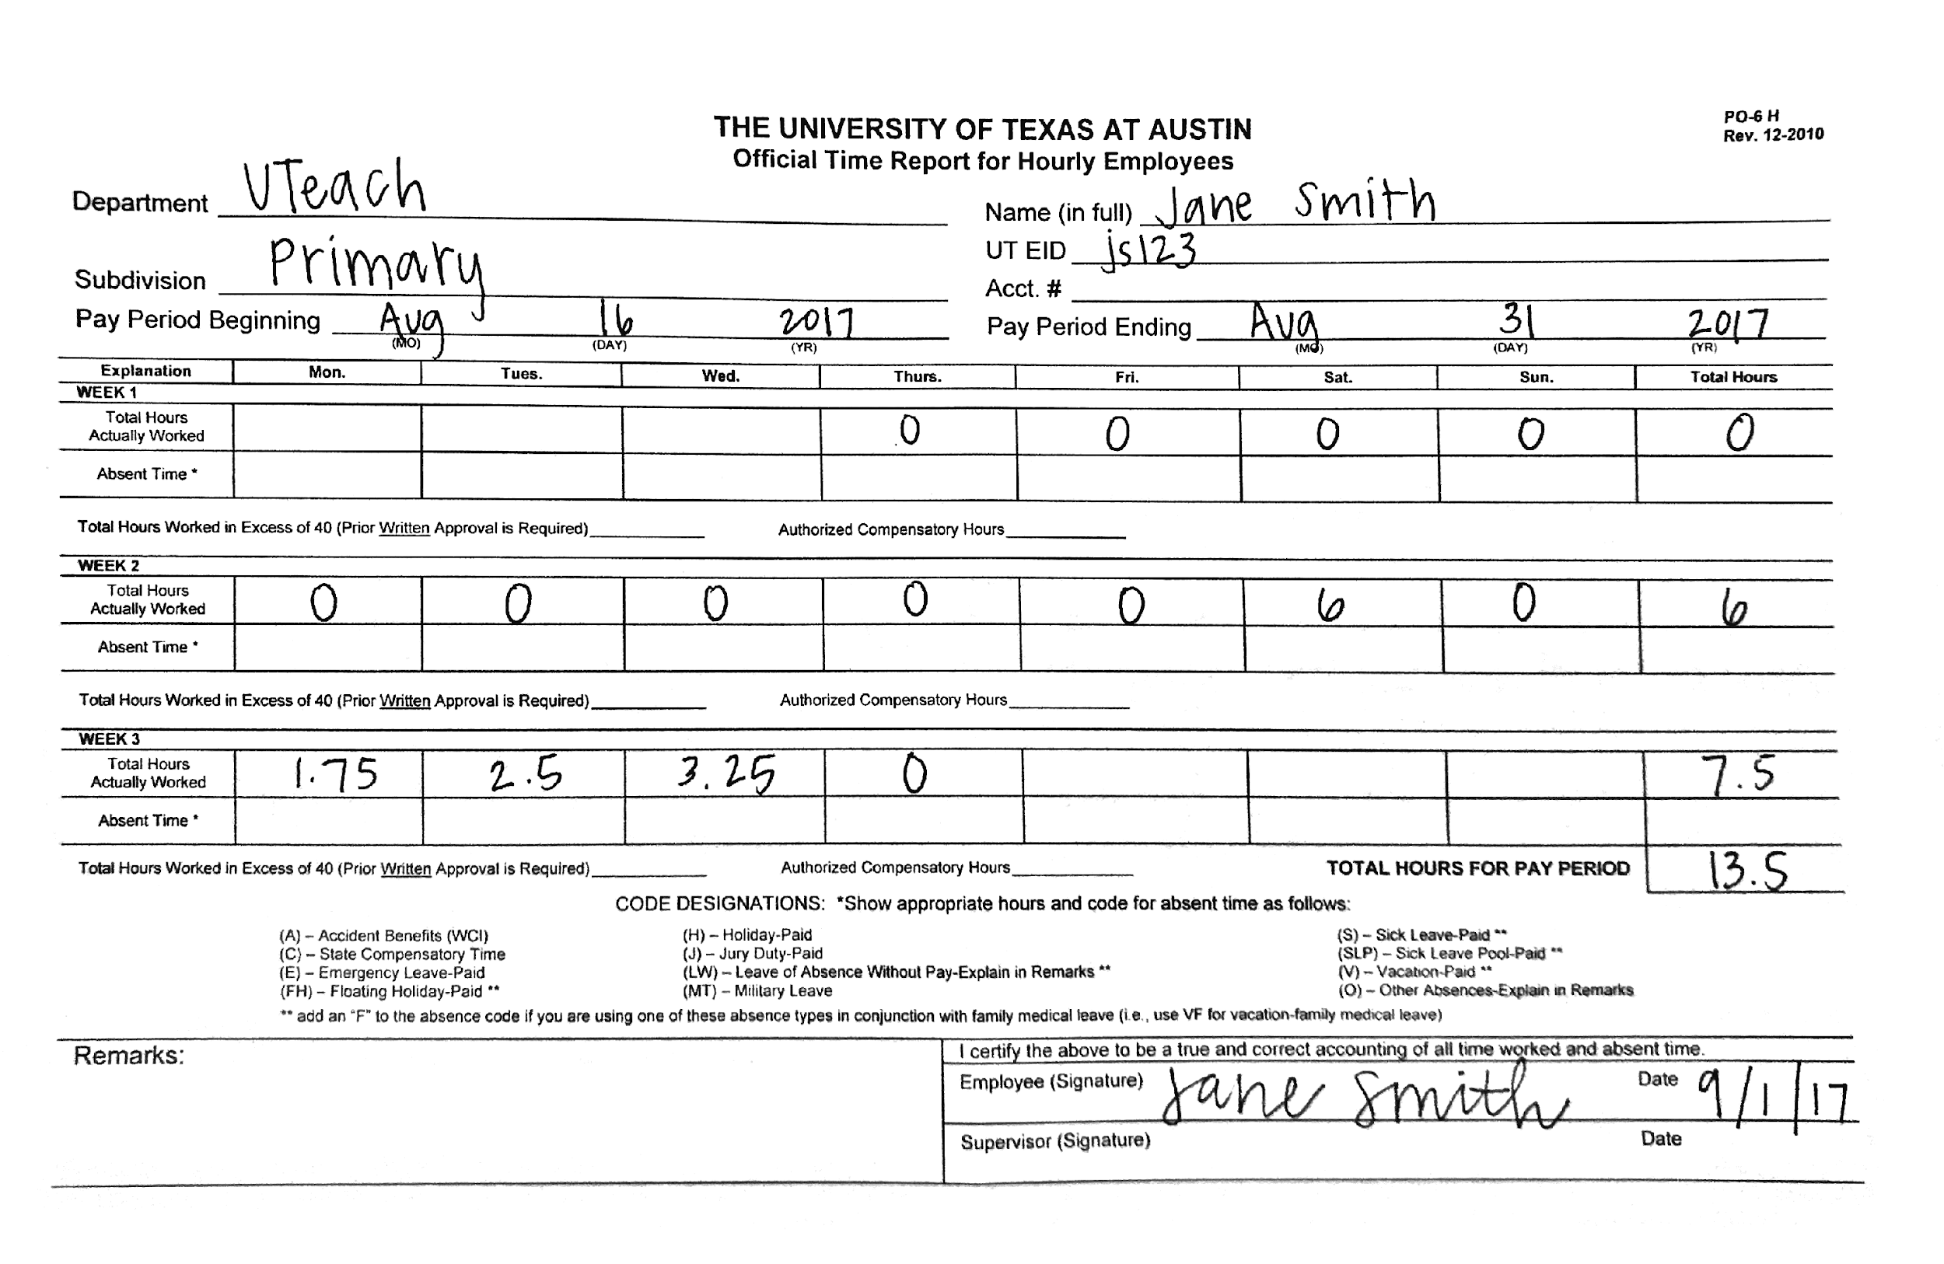

Slide 45
Don’t put anything in the “Absent Time” rows.
Leave the remarks section empty. Email me if you have any comments for your time sheets.
Come see me personally so that I can check your hours in front of you (or you may have to make several trips to fix your time sheet).

Slide 46
Time sheets not fixed in time or not turned in on time will be processed when the next time sheets are due.
Blue or black ink only.
You must sign your time sheet for it to be valid.
If you make a mistake, simply cross out the mistake, put the correction next it, and initial.

Slide 47
FILLING OUT A TIMESHEET
You MUST complete your weekly report, allowing me to check your hours.
BEFORE they are due at 3 pm, bring your timesheet in to me, I will check it, sign off if it is okay, and turn it in for you
You can turn it in anytime (even the day before) as long as it is before 5 and you aren’t working anymore for that day.

Slide 48
First Timesheet!
Timesheet is due September 4th by 3 pm for the pay period August 16th- 31st

Slide 49
ADMINISTRATIVE | LAB SAFETY
Rachel Ray

Slide 50
LOCATIONS
Broken Glass container
Eye wash station
Acid cabinet
Flammables cabinet
MSDS binders (2)
Fire Extinguisher
Spill Kit
Goggles, gloves, aprons

Slide 52
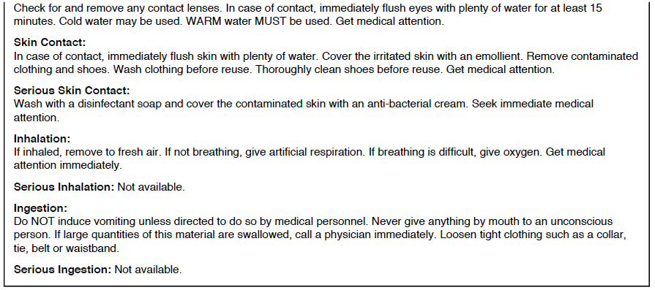

Slide 53
PRECAUTIONS
No eating or drinking in 7.114 (for any class in this room)
Put drinking containers on counters on perimeter of room, drink outside classroom.

Slide 54
CHEMICAL SEPARATION
Acid Cabinet:
Just HCl
Flammable Cabinet:
Just Ethanol
and Hexane
Don’t put acids in Flammable Cabinet!

Slide 55
CHEMICALS IN 7.114
Everything needs to be upright.
In K10 & K12:
Everything else except moth balls, cooking stuff, and epsom salt

Slide 56
That’s all folks.

