Slide 1
Promoting oral proficiency at the intermediate level
Melissa D. Murphy, Ph.D.
Spanish Language Program Director
Associate Professor of Instruction
The University of Texas at Austin
mmurphy@mail.utexas.edu

Slide 2
Lower-division Language sequence
3 semester sequence since 2010
Intensive courses (6 + 6 + 6)
2010-2020 | Since 2020
SPN 601D | SPN 601D
SPN 610D | SPN 610D
SPN 611D | SPN 311 (required)
 | SPN 314 (optional)

Slide 3
SPN 311 + SPN 314
Decisions:
Redesign SPN 611D and turn it into a 3-credit course (SPN 311) for requirement
Straightforward
Same basic content, less in-depth
Make SPN 314 a brand new “Conversation & Culture” course
Opportunity to work on speaking skills and intercultural competence
Student interest in taking additional Spanish courses (not “composition” ☺)
Courses can be taken concurrently
No textbook; materials on Canvas

Slide 4
SPN 314 Course description

Slide 5
Thematic content
 | SPN 311 (third semester Spanish) | SPN 314 (conversation & culture)
1 | Physical appearance & personality Stereotypes Beauty and self-esteem | Concepts of beauty, colorism, bullying Short film: “El sándwich de Mariana” Film: Pelo malo
2 | Events that changed the world Social achievements Festive rituals | Feminism, indigenous peoples Video: “Latinoamérica indígena” (World Bank) Film: También la lluvia
3 | Environment Marketing Rights and responsibilities | Laws and norms, global challenges, political protest Short film: “10 minutos” Film: No
4 | Lifestyles Study abroad Communication between cultures | Prejudice, immigration, culture shock Short film: “Namnala” Film: Student choice (list of 12 to choose from)

Slide 6
COURSE Structure
At home:
Activities based on readings and videos
(one before each class day)
In class:
- Pair, small group, and whole class discussions, presentations, debates, etc.
- No specific / standardized in-class activities
Instructor autonomy (faculty, not AIs) / decisions based on particular group
More organic development of discussions
Fewer time constraints

Slide 7
4 modules on canvas

Slide 8
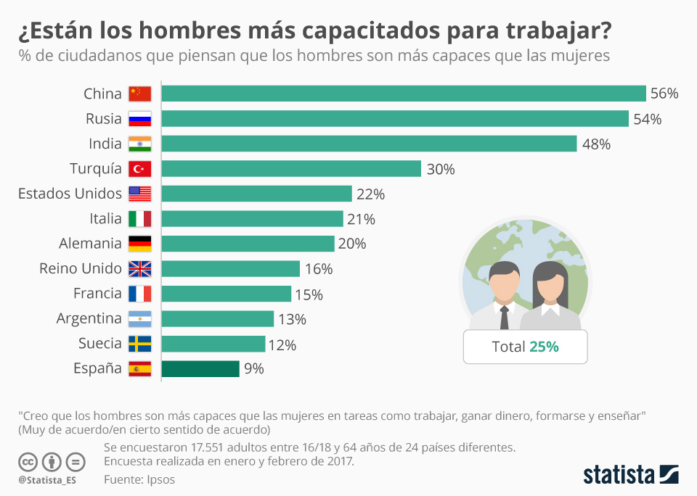
“introducción al tema”

Slide 9
Reading activities

Slide 10
Reading activities
Types of questions asked (in Spanish):
Write your own definition of colorism.
Mention 2-3 things you learned from the reading.
Do you think colorism is prevalent in the U.S.? Can you think of an example?
Make a list of 5 words you learned from the reading.

Slide 11
Reading activities

Slide 12
Reading activities
Types of questions asked (in Spanish):
Summarize the arguments made.
Which do you agree with most and why?
What conclusions can you draw from reading these comments?

Slide 13
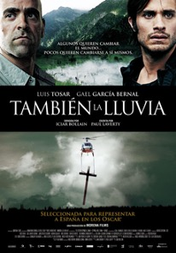
Films (one per module)

Slide 14
Films: pre-viewing activities
Types of questions asked (in Spanish):
Listen to 3-minute audio about the film Pelo malo. Then answer a few questions about the movie, the term “pelo malo”, and its connotations.
Visit the the following website and find information about the director, location of filming, the historical context, etc.
Look at the images of Caracas from the film and describe how they make you feel.
Jot down 3 or 4 themes you think will be addressed in the film.

Slide 15
films: post-viewing activities
Types of questions asked (in Spanish):
Describe the characters, their behaviors, and their feelings.
Which character is the most complex? Why?
Describe the neighborhood.
Does the director have an impartial view of Caracas & Venezuela?
What stereotypes can you identify?
Did you like the film?
What was the main message you got from it?

Slide 16
Module 4: movie choice

Slide 17
Grammar in context (ser & estar)

Slide 18
Grammar in context (subjunctive)

Slide 19
Grammar in context (review)

Slide 20
assessments
HW / participation (15%)
Vocabulary lists (15%)
Journal entries (15%)
Exams (25%)
In-class speaking activities (15%)
Conversifi conversations (15%)

Slide 21
Exams
1. Speaking: Questions about course themes, films and readings; students record 1minute responses [40pts]
Ex: Briefly describe the plot of El sandwich de Mariana. In your opinion, what is the main message of this short film?
Ex: Mention some strengths and weaknesses of the film No. Would you recommend it to a friend? Why or why not?
II. Writing: Open-ended questions about course themes, films and readings [40pts]
Ex: Identify the characters in the photos below and write a description of each one (personality & physical appearance)
Ex: Write a movie review about the film you chose to watch in Module 4. What does it teach us about immigration?
III. Grammar in context: Primarily fill-ins and multiple drop-downs [20pts]

Slide 22
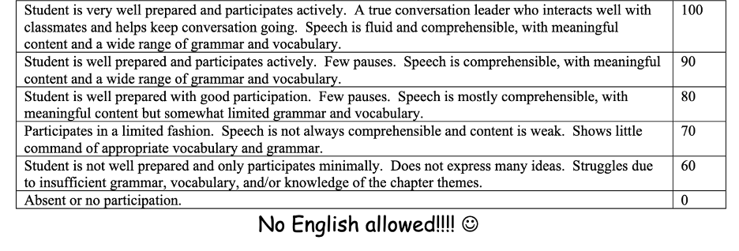
In-class speaking assessments
Students are given a list of 8-10 questions/topics to discuss.
They discuss them in groups for about 30 minutes.

Slide 23
In-class speaking assessments
Types of questions / prompts (in Spanish):
What worries you the most about your future?
What does a grade represent to you?
What are the hardest parts of studying abroad?
Who is responsible for social welfare?
Why do you think immigration is so controversial?
How do we know if we are tolerant?
Do you think the values of people belonging to different social classes are different? Explain.
Do you think there are countries where people aren’t obsessed with youth and physical appearances? If so, what makes them different?

Slide 24
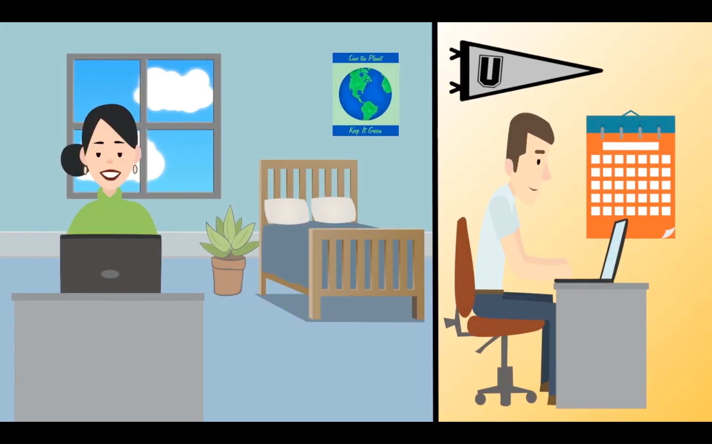
conversifi

Slide 25
conversifi
Follow-up activity (in Spanish)
What was the most successful aspect of your conversation?
What was the greatest difficulty you had?
What communicative strategies helped you the most?
Identify and explain 2 grammatical errors you made in your conversation.
What did you learn from your conversation partner? Summarize what they told you about the topic.

Slide 26
Student comments about the course
“I really enjoyed how this class was more about class participation and speaking practice instead of purely worksheets and written/grammatical work.”
“I love the structure of the course with many short films and movies that help us learn how Spanish is truly spoken and learn about Spanish and Latin American culture.”
“I feel like coming into this course, speaking was the weakest out of all of my Spanish skills, but this course has really helped with that.”
“I loved the assignments, especially the movies, because they talked about real and important topics that come up day to day.”
“Although I am a heritage speaker, this class helped me develop a stronger vocabulary and more confidence.”
“My conversation skills have improved drastically in this course.”

Slide 27
Thank You!!!
Melissa Murphy
mmurphy@mail.utexas.edu

