Slide 1
Psychology Honors Program
Dr. Bertram Gawronski
Honors Instructor, Spring-Fall 2024

Slide 2
Overview
What is the Honors Program?
Who is the Honors Program for?
Stage 1: Prepare for Honors Program
Stage 2: Develop Your Research Proposal
Stage 3: Complete and Present Your Research
Application Materials
General Information
Questions and Answers

Slide 3
What?
Who?
Stage 1
Stage 2
Stage 3
Application
Resources
Q&A
What is the Honors Program?
Design and perform independent research project under guidance of faculty mentor with active research program.
Program culminates with poster presentation at Honors Research Symposium and completed honors thesis.
Honors students get a preview of a research-focused graduate program.

Slide 4
What?
Who?
Stage 1
Stage 2
Stage 3
Application
Resources
Q&A
What Is the Honors Program?
PSY 458: Experimental Psychology
Taken prior to beginning honors program or in first semester; designed to provide exposure to conducting and writing research
PSY 359H: Honors Research I
Taken in first semester; students develop the ideas, scholarly background, and methodology of the honors project, and present these in oral and written formats
PSY 379H: Honors Research II
Taken in second semester; students complete data collection and analysis, and present results in poster presentation and honors thesis
PSY 158H: Individual Instruction
Registered in second semester; designed to receive supervision of faculty member and lab

Slide 5
What?
Who?
Stage 1
Stage 2
Stage 3
Application
Resources
Q&A
Who Is the Honors Program for?
Formal Requirements
Psychology major; upper-division standing
Overall UT GPA of at least 3.25; PSY GPA at least 3.5
Completion of PSY 301 & 418/420M
Completion of 6 hours of upper division PSY courses
(not including PSY 420M, PSY 357, or PSY 359)
Highly Recommended
Prior research experience (e.g., PSY 357)
Motivation and opportunity to invest more than usual
Confirmation of supervision by faculty mentor
Interest in pursuing research career

Slide 6
What?
Who?
Stage 1
Stage 2
Stage 3
Application
Resources
Q&A
Prepare for Honors Program
Find a Topic Area
Something you are still excited about in at least two years
Get Research Experience
Join a lab, PSY 357 (note: PSY 458 does not count)
Read Scientific Articles
Learn about current questions in your topic area
Search for Potential Faculty Mentor
Create connection early (note: some faculty only advise students who are already in their lab)
Generate Project Idea
Honors projects are most often a “blend” of student’s ideas and input from faculty mentor

Slide 7
What?
Who?
Stage 1
Stage 2
Stage 3
Application
Resources
Q&A
Prepare for Honors Program
Resources
Search PSY 357 Descriptions
https://liberalarts.utexas.edu/psychology/undergraduate-program/research-opportunities/psy-357-research/
Undergraduate Research Info Sessions
https://ugs.utexas.edu/our/start/info-sessions
Departmental Area Websites
https://liberalarts.utexas.edu/psychology/areas-of-study/
Faculty and Lab Websites
https://liberalarts.utexas.edu/psychology/research-faculty/faculty.html
Contact Professors (see sample email on handout)

Slide 8
What?
Who?
Stage 1
Stage 2
Stage 3
Application
Resources
Q&A
Develop Your Research Proposal
First Semester (Honors Research I)
Choose independent research project topic
Prepare literature review of the project topic
Develop hypotheses, design, and methodology
Obtain IRB approval
Present research proposal in oral format
Prepare research proposal in written format
Ideally: Begin data collection

Slide 9
What?
Who?
Stage 1
Stage 2
Stage 3
Application
Resources
Q&A
Complete and Present Your Research
Second Semester (Honors Research II)
Develop detailed analysis plan
Complete data collection
Analyze data
Interpret findings
Prepare poster presentation
Present poster at Honors Research Symposium
Prepare written report (Honors Thesis)

Slide 10
What?
Who?
Stage 1
Stage 2
Stage 3
Application
Resources
Q&A
Application Materials
Research Experience
Be specific! Explain the project(s) you were involved in, your role, and what you did
Topic Area and Project Plans
If you already have a faculty mentor who agreed to supervise a specific project, mention that and describe the details of the project
Otherwise, describe your project idea at a medium level of specificity and mention potential faculty mentors with relevant expertise who might be willing to supervise your project
Postgraduate Plans
What do you want to do after you graduate, and how would an honors project help you accomplish your goals?

Slide 11
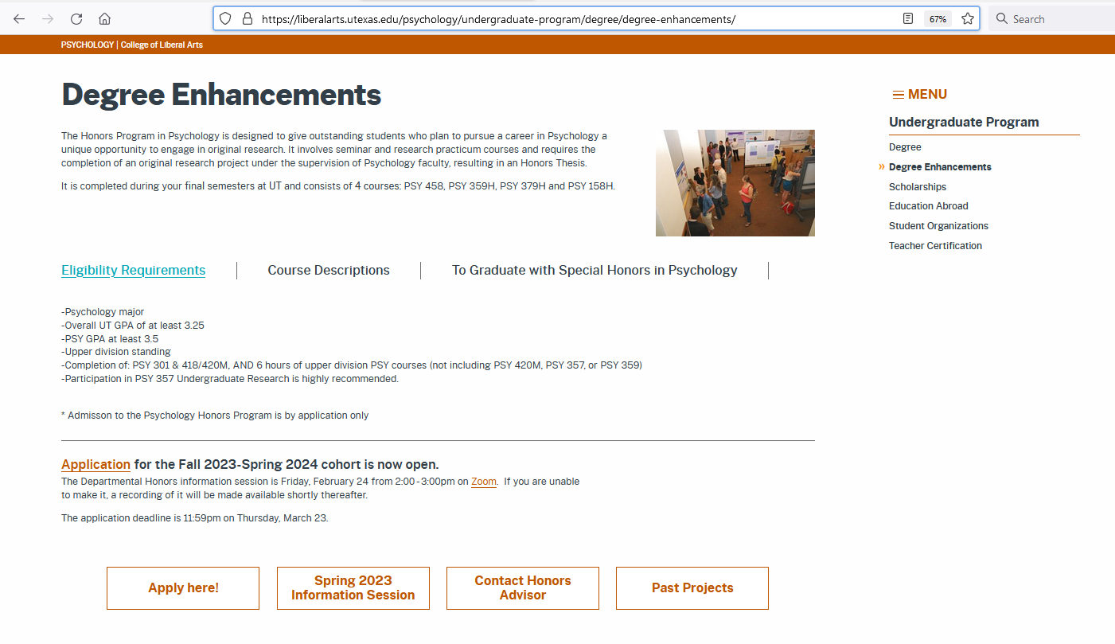
What?
Who?
Stage 1
Stage 2
Stage 3
Application
Resources
Q&A
General Information
https://liberalarts.utexas.edu/psychology/undergraduate-program/degree/degree-enhancements/

Slide 12
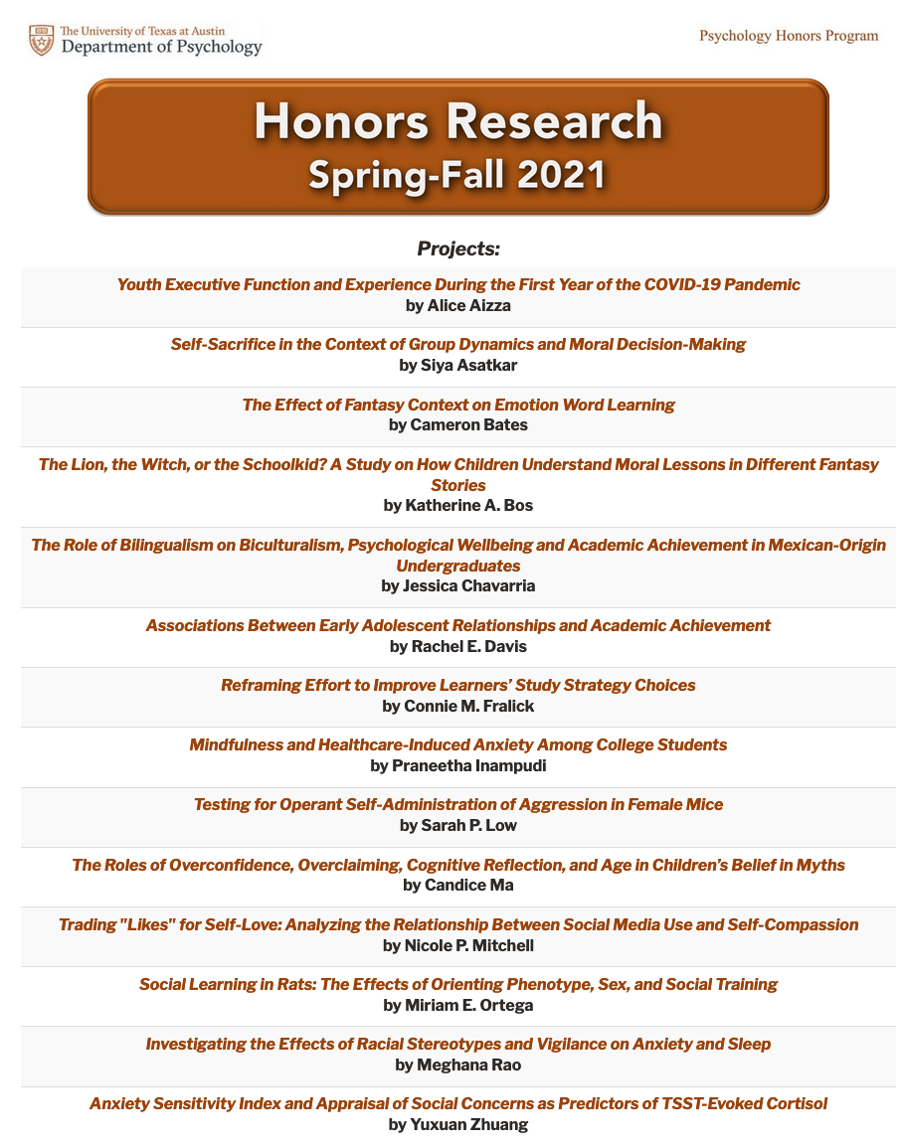
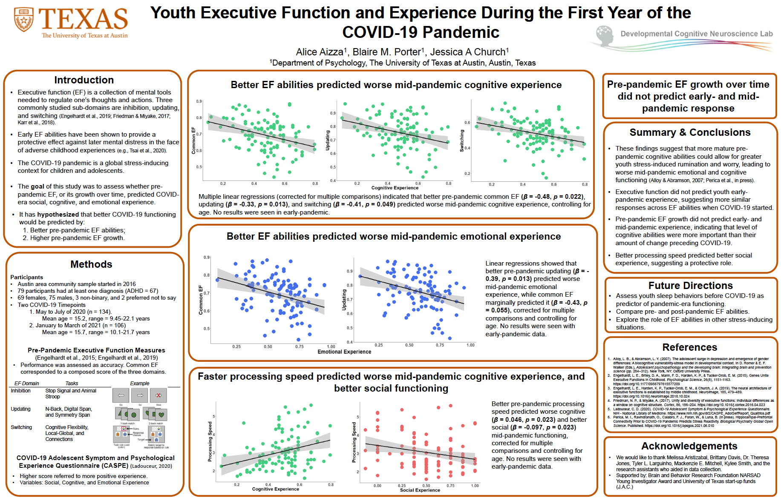
What?
Who?
Stage 1
Stage 2
Stage 3
Application
Resources
Q&A
Sample Projects
https://sites.utexas.edu/psyhonors18/

Slide 13
What?
Who?
Stage 1
Stage 2
Stage 3
Application
Resources
Q&A
Sample Projects
https://sites.utexas.edu/psyhonors18/

Slide 14
What?
Who?
Stage 1
Stage 2
Stage 3
Application
Resources
Q&A
Questions?

