Slide 1
CO₂-EOR Technology
Larry W. Lake
The University of Texas at Austin
(512) 471-8233
Larry_Lake@mail.utexas.edu
Petroleum Science and Technology Institute
July 2022

Slide 2
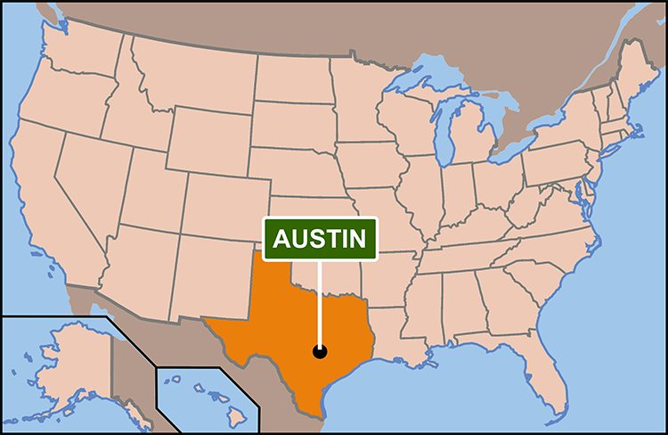
The University of Texas at Austin
Founded in 1883
52,000 students enrolled from more than 100 countries (11,000+ in grad school)
Annual operating budget: $3.6B
Research funding: $640M
3,000 faculty, 18,000 staff
18 colleges and schools
7 museums, 17 libraries
482,000+ alumni
PGE: 350 UG; 150 Grad

Slide 3
General Behavior

Slide 4
Producing Phases...
Primary
Secondary
Tertiary
Oil Rate
0.10
0.25
0.10
EL
_
Inj.
P
P
Prod.
Lim
Ave. S_{o}
Time

Slide 5
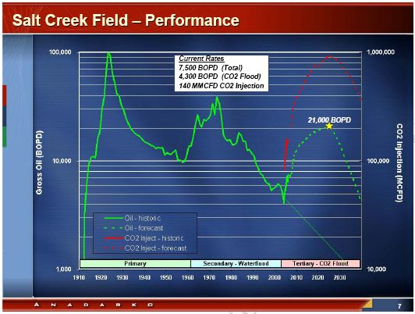


Slide 6
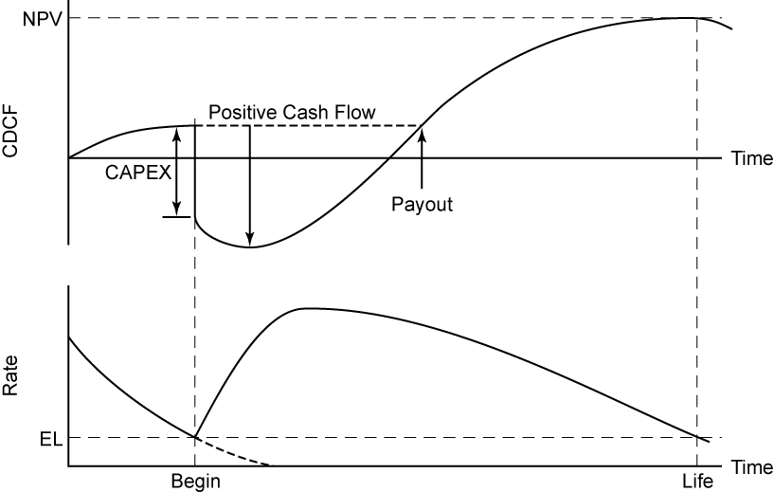
Producing Phases...

Slide 7
Enhanced Oil Recovery (EOR) is…
Oil recovery by injection of fluids not normally present in reservoir
Excludes pressure maintenance or waterflooding
Not necessarily tertiary recovery
End of the road
Improved Oil Recovery (IOR) is…
EOR plus additional technologies dealing with drilling, production, operations, and reservoir characterization
An attempt to avoid negative connotation of EOR

Slide 8
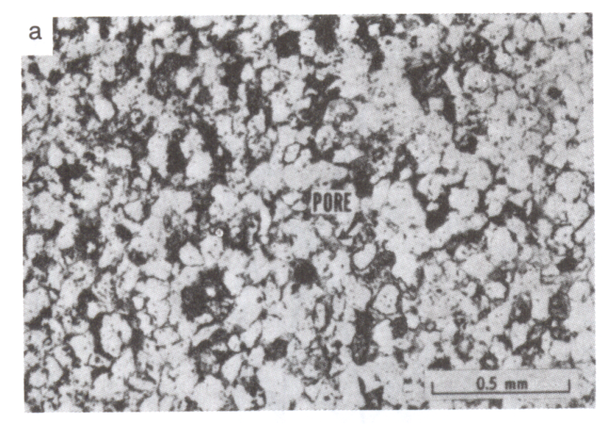


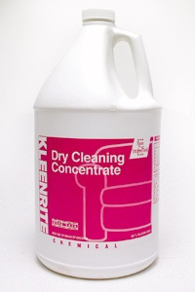
EOR is End Of the Road
Chemical
Thermal
Solvent/Gas

Slide 9
CO₂ Background

Slide 10
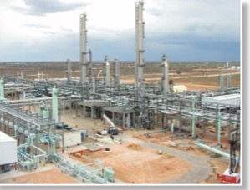
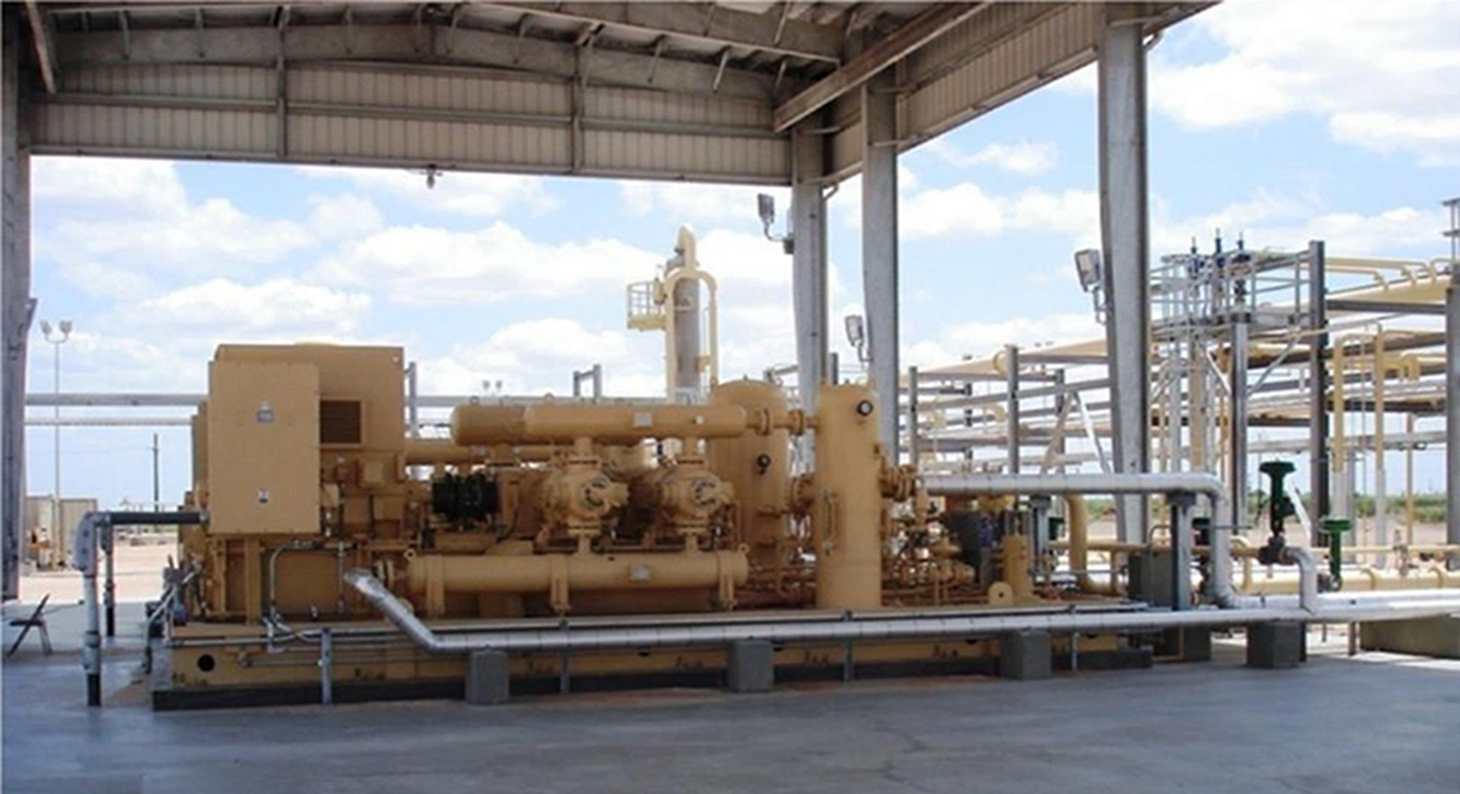

Solvent CO₂ Flooding
Compressor
Gas Plant
Injection well head

Slide 11
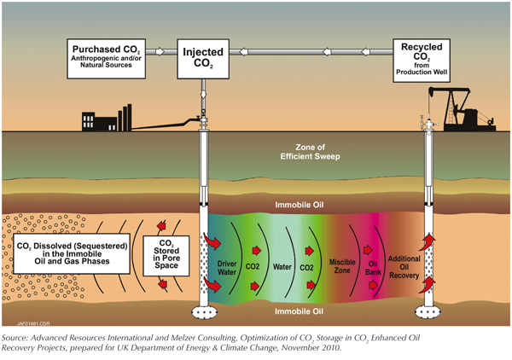
Schematic of Solvent Flooding…
Fig. 7-1

Slide 12

Residual Oil Zone (ROZ) vs.
Main Pay Zone (MPZ)
Time
Gas Cap
Gas Cap
Gas Cap
Producing
MPZ
Producing
MPZ
Original
MPZ
Natural
Water
Flow
ROZ
Spill point
MPZ
Spill point
MPZ
MPZ
ROZ
ROZ
MPZ
Aquifer flow
Aquifer
Aquifer flow
(‘natural waterflooding’)
MPZ: main pay zone
Ren and Duncan, 2019
Notes:
Isn’t this just one of the possible explanations?
Yes, just one of the explanations. This one is pretty well accepted, but that does not mean it is true.
We are testing the secondary oil migration model. ROZs might be the residuum during secondary oil migration.

Slide 13
Solvents-A fluid that recovers oil by mass transfer
Alcohols
Nitrogen
Air
Flue gas
Various petroleum gas (C₃)
Methane
Carbon dioxide
Hydrogen sulfide
Ethane
DME

Slide 14
CO₂ Sources

Slide 15
Naturally Occurring CO₂

Slide 16
CO2 Sources and Projects in the US, 2020

Slide 17
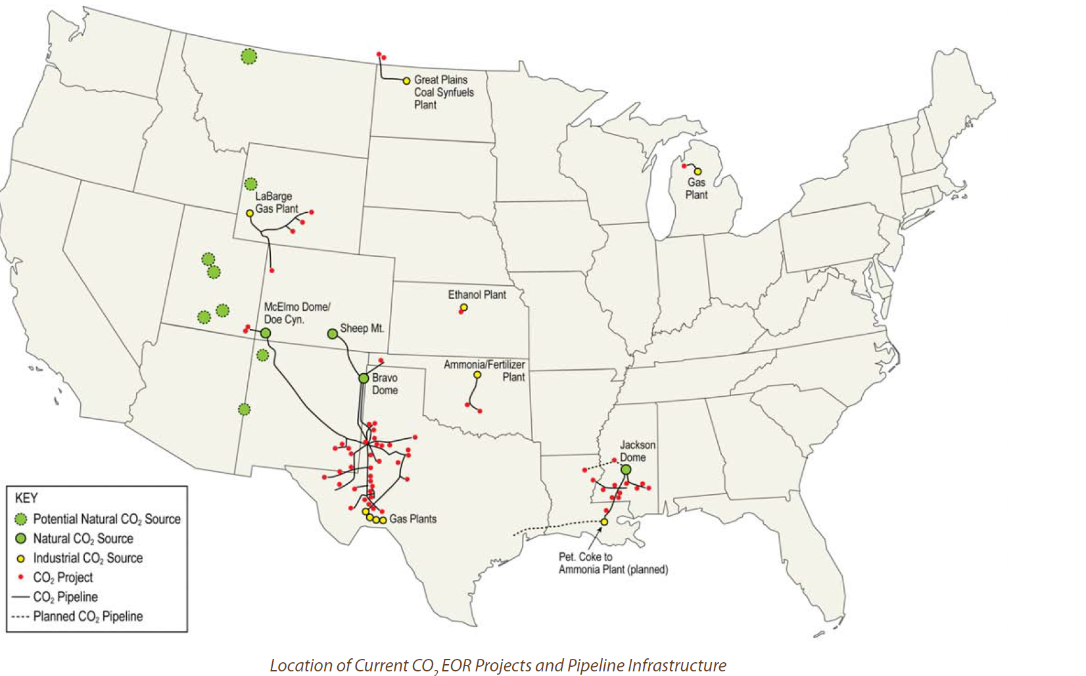
Existing CO2 EOR Infrastructure and Projects
St. Johns
Petro Nova CO2 from Coal
Notes:
Will use. OK?

Slide 18
Mississippi/Louisiana CO₂ EOR Projects
Source: Denbury Resources, 2005

Slide 19
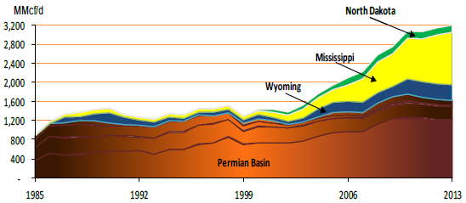
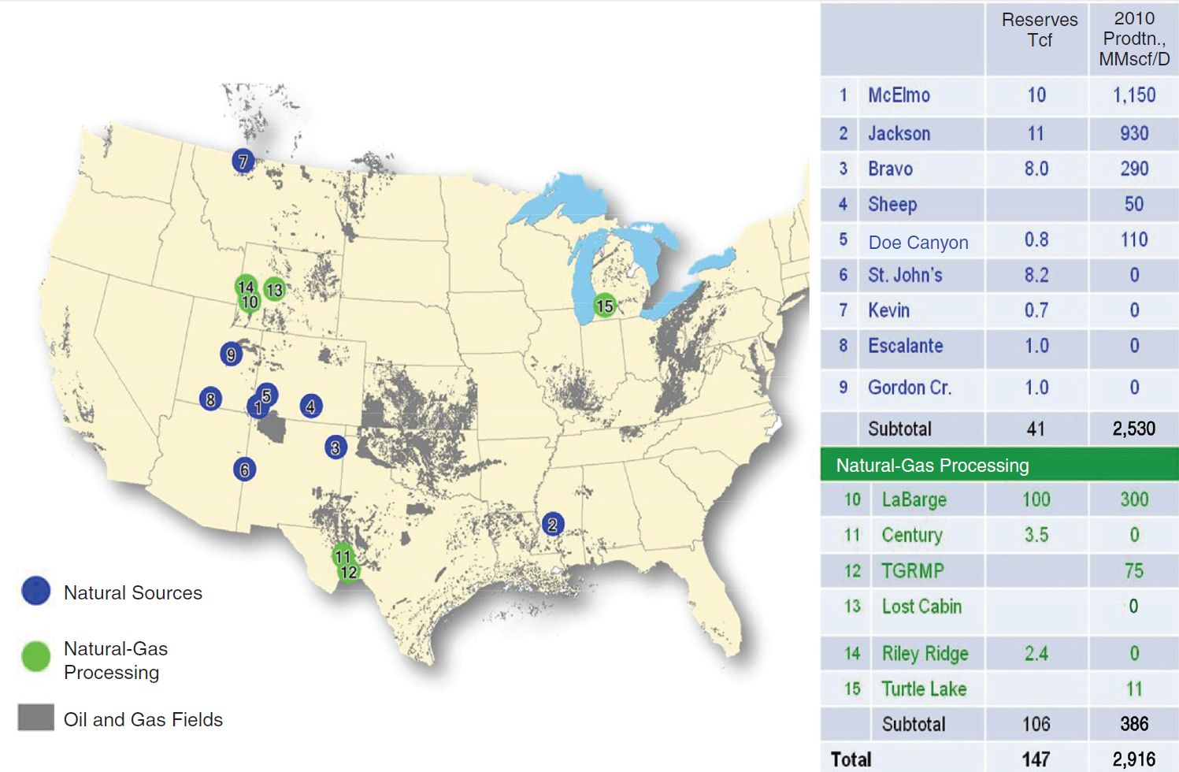
US Lower 48 CO2 Supplies – DOE 2012
Notes:
Maybe this on also

Slide 20
Naturally Occurring CO₂

Slide 21
CO₂ Sources
Power plants (esp. coal fired, 3-8%)
Cement plants (30%)
Steam methane reforming (30-45%)
Ethanol plants (98-99%)
Refineries (8-20%)
Ammonia plants (98-100%)
Planes, trains and buses (14-19%)

Slide 22
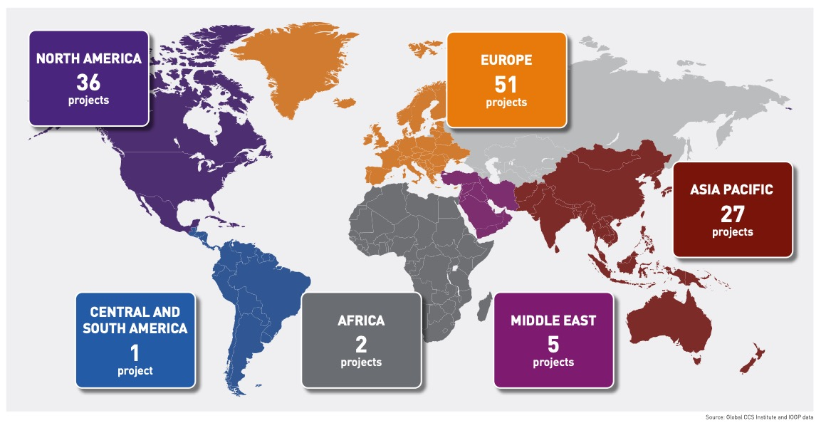
Global CO₂ Storage
From Livescu (2021)

Slide 23
CO₂ Properties

Slide 24
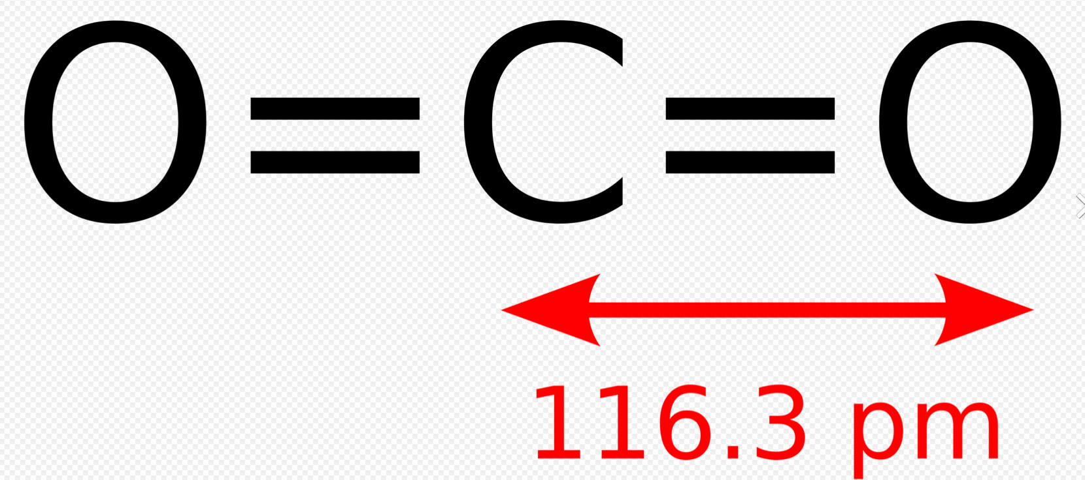
Basic Properties….

Slide 25
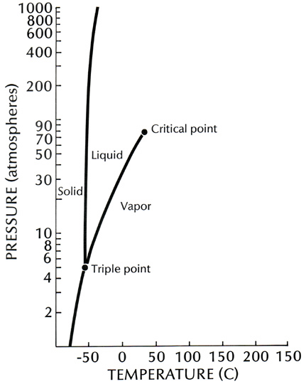
Properties of CO₂...
Supercritical fluid
Oil extracting ability of solvents is
related to physical properties
CO₂ has a high T_{c} but low P_{c}
In most applications, is a supercritical liquid
It is an excellent oil extracting agent

Slide 26
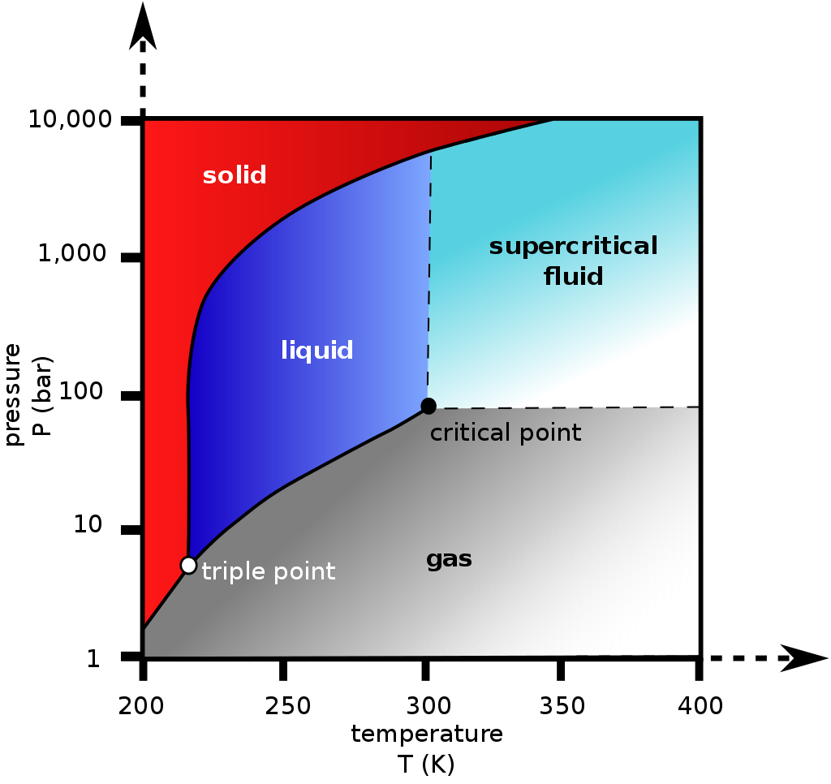
Properties of CO₂...
Subsurface CO2 is supercritical

Slide 27
Solvent Comparisons
CO₂ has density of a liquid
and the viscosity of a gas

Slide 28
Miscibility Pressure

Slide 29
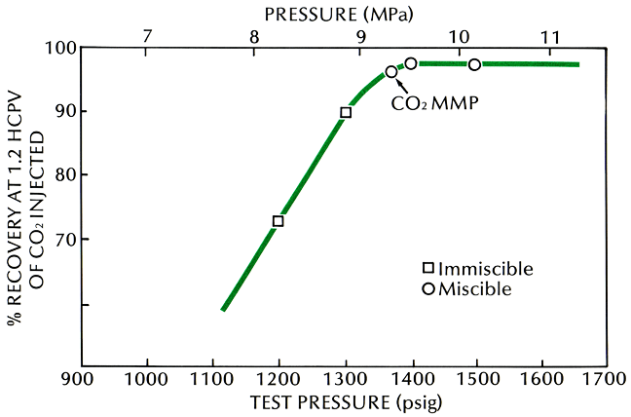
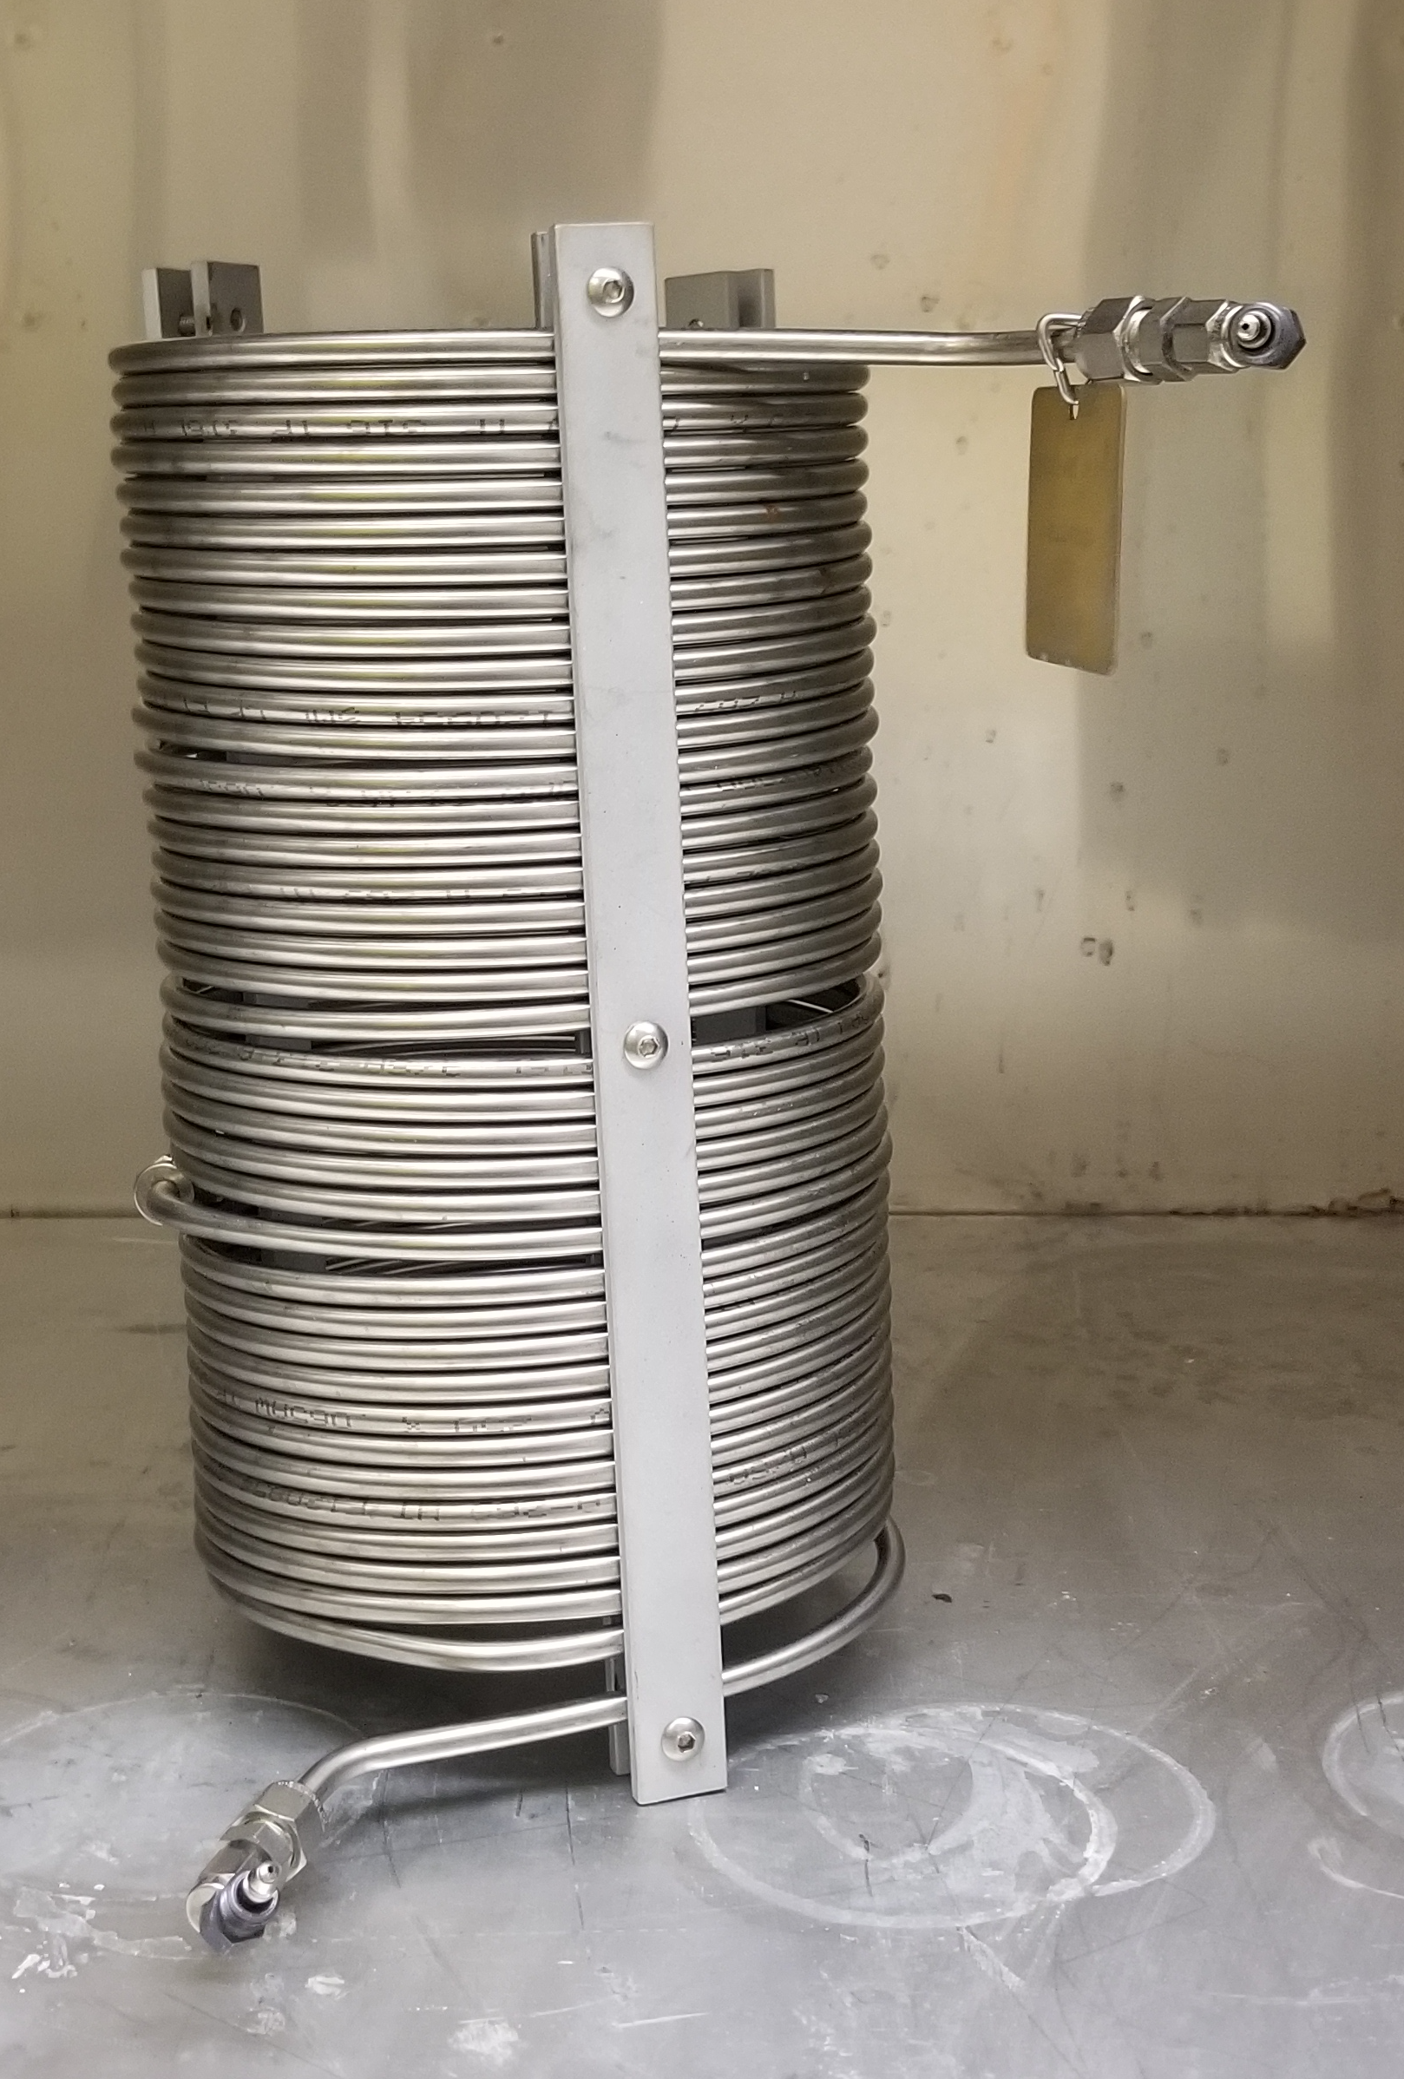
Summary of Slim Tube Experiments...
Length: 1.5-25.6 m
ID: 0.46-1.98 cm
Packing: Glass beads-220 mesh sand
Permeability: 1.4-20 μm²

Slide 30
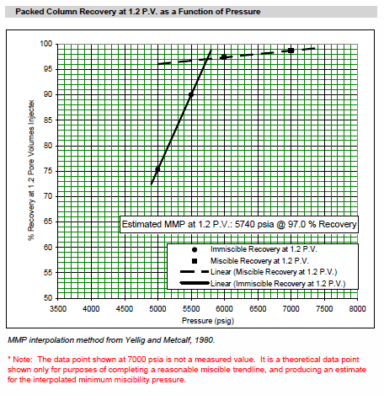
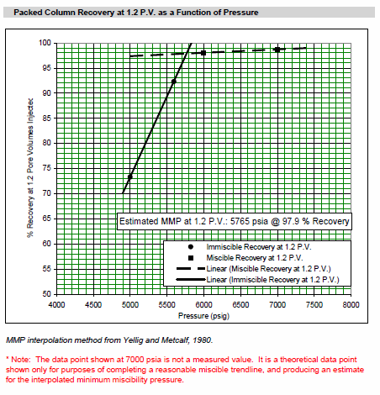
MMP Measurements

Slide 31
Flow Properties

Slide 32
Basic Oil Recovery Equation

Slide 33
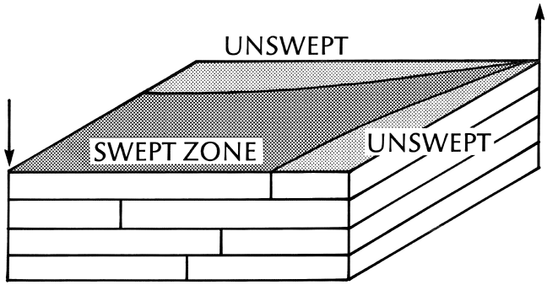
Areal Sweep Efficiency Schematic...
Fig. 6-1

Slide 34
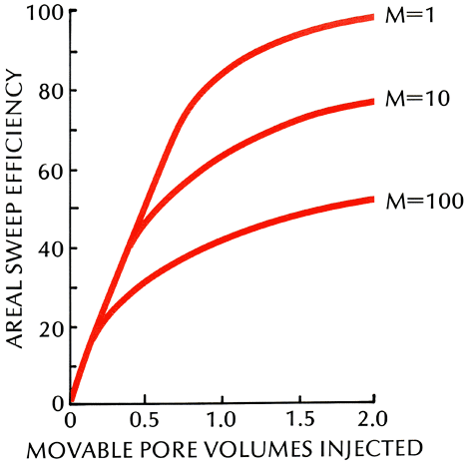
Five-Spot Areal Sweep...

Slide 35
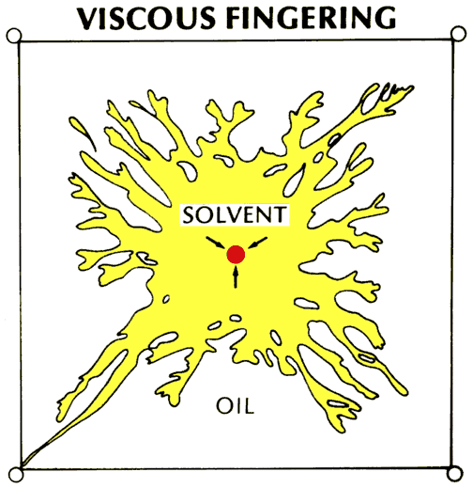

Slide 36
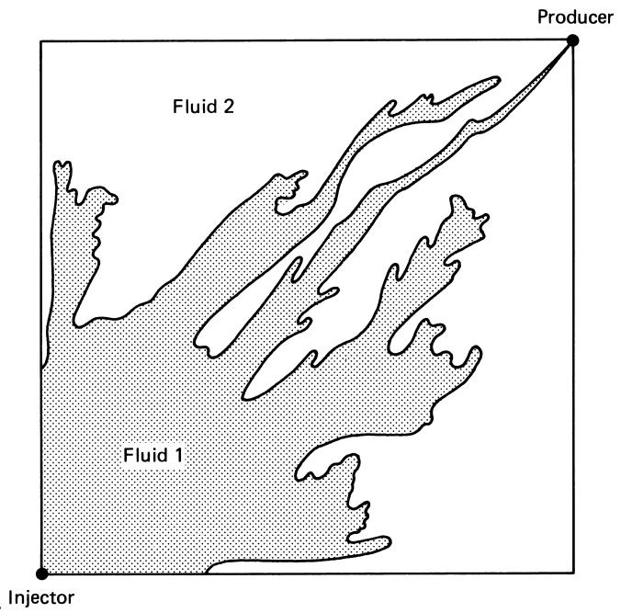
Viscous Fingering in a Quarter Five-spot Model, Mº = 17
Fig. 6-19

Slide 37
Basic Oil Recovery Equation

Slide 38
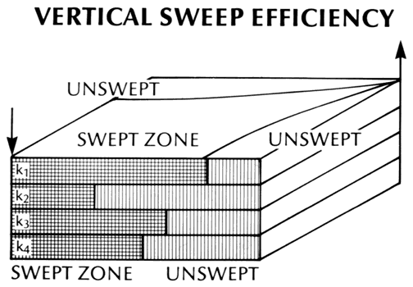

Slide 39
Volumetric Sweep Efficiency

Slide 40
Spot the Differences: CCS vs. CO₂ EOR
CCS
CO₂ EOR
No revenue
Profit driven
Multiphase flow
Multiphase flow
No (proven) trap
Field-demonstrated trap
Injection wells
Injection and production wells
Semi-steady state operation
Steady-state
CO₂ captured and injected
CO₂ production, separation, reinjection
CO₂ purchased

Slide 41
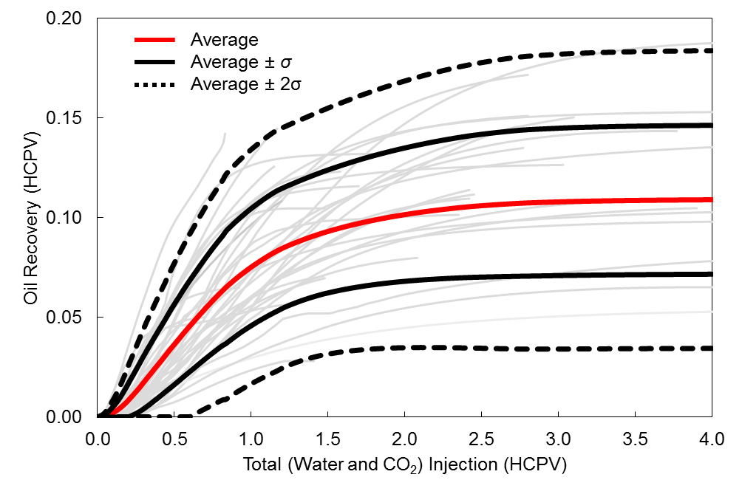
50 yr experience with aggregated reservoir performance: oil recovery
Notes:
Define HCPV

Slide 42
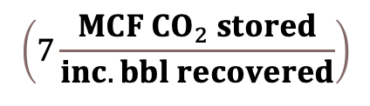

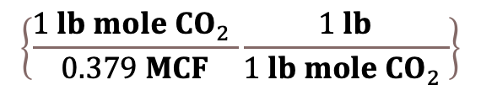
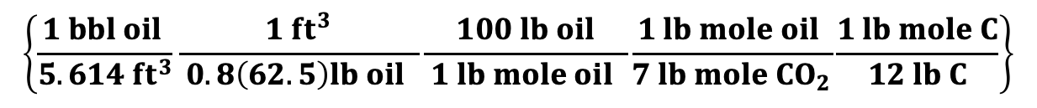
Are we really storing CO₂?
$$\left(7\frac{MCF CO_{2} stored}{inc. bbl recovered}\right)$$
given
$$\left\{\frac{1 lb mole CO_{2} }{0.379 MCF}\frac{1 lb}{1 lb mole CO_{2} }\right\}$$
Conversion factors
$$\left\{\frac{1 bbl oil }{5.614 {ft}^{3}}\frac{1 {ft}^{3}}{ 0.8\left(62.5\right)lb oil }\frac{100 lb oil}{ 1 lb mole oil }\frac{1 lb mole oil }{7 lb mole CO_{2}}\frac{1 lb mole C}{12 lb C}\right\}$$
= $1 \frac{lb C stored}{ lb C releasd}$

Slide 43
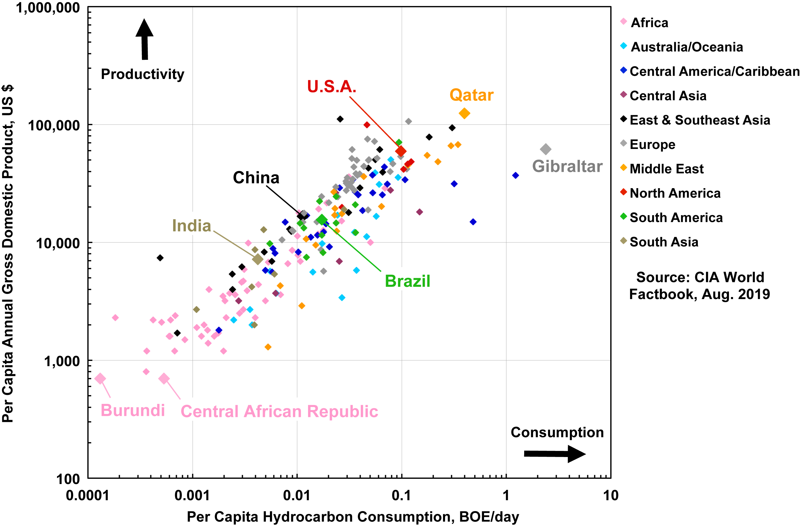
The Conundrum

Slide 44
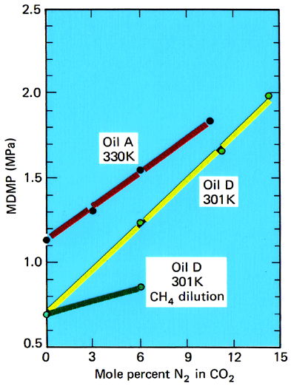
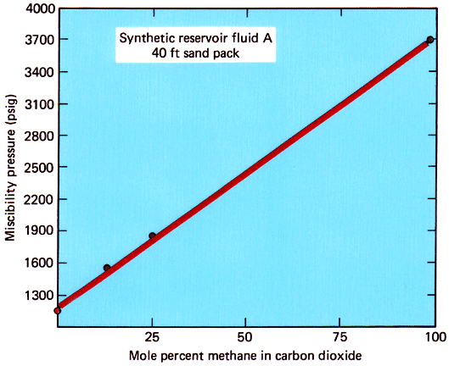
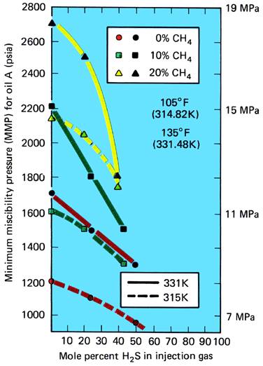
Solvent Contamination
Fig. 7-26

Slide 45
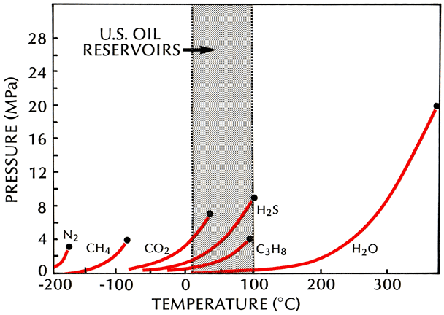
Vapor Pressure of Pure Substances...

Slide 46
Numerical Simulation

Slide 47
Basic Equations...
Conservation of
  Mass
  Energy
Empirical laws
  Darcy
  Capillary pressure
  Phase behavior
  Fick
  Reaction rates

Slide 48
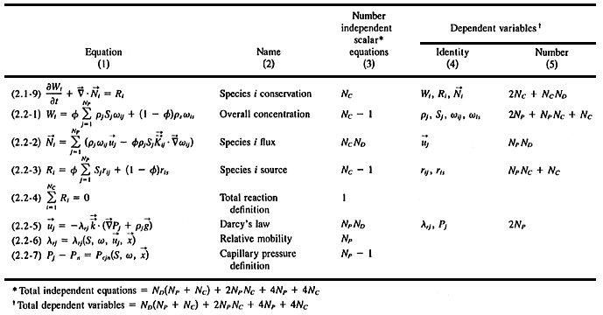
Basic Equations...

Slide 49
Simulation Schematic...
Grid block
or cell
Out
Out
z
y
In
Out
x
In
In
Conservation law...
{Rate In} - {Rate Out} = {Accumulation}
For each component (oil, gas, water, energy)
For each cell

