Slide 1
Faculty Council Photograph
September 16th at 2:00 pm
in the Main Building at the South Entrance

Slide 2
WELCOME!

Slide 3
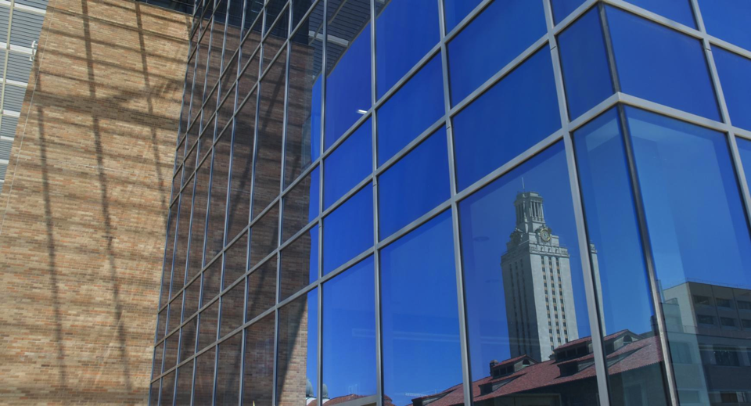
General Order of Business
Report of the Secretary
Approval of Minutes
Communication with the President
Report of the Chair
Report of the Chair Elect
Unfinished Business
Reports of the General Faculty, Colleges, Schools, and Committees
New Business (Presenters)
Announcements and Comments

Slide 4
Report of the Secretary
Memorial Resolution Committees appointed
Memorial Resolutions completed
Welcome returning and new members
Status of Legislation & Resolutions
Faculty Council Officers
Other Legislation
Graduate Student Funding Resolution
Resolution Regarding Conferral of Degrees

Slide 5
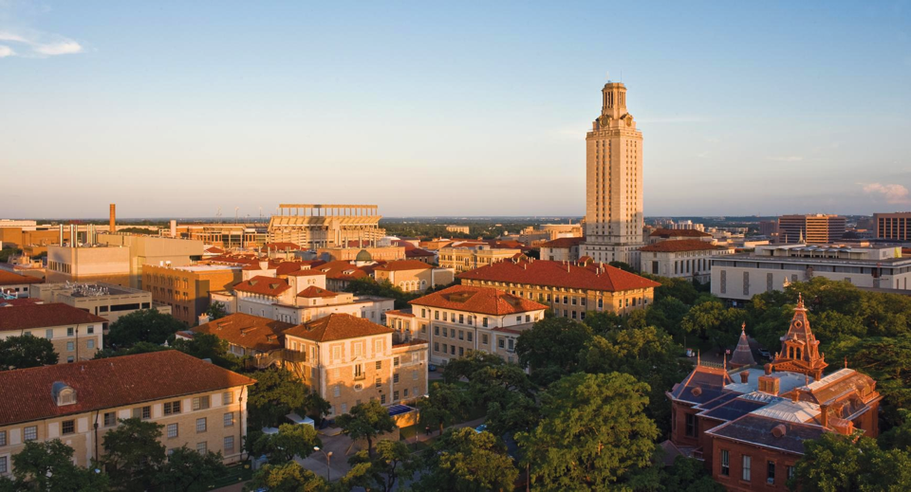
Approval of Minutes
Approval of the May 6th special meeting minutes
Approval of the May 6th regular meeting minutes

Slide 6
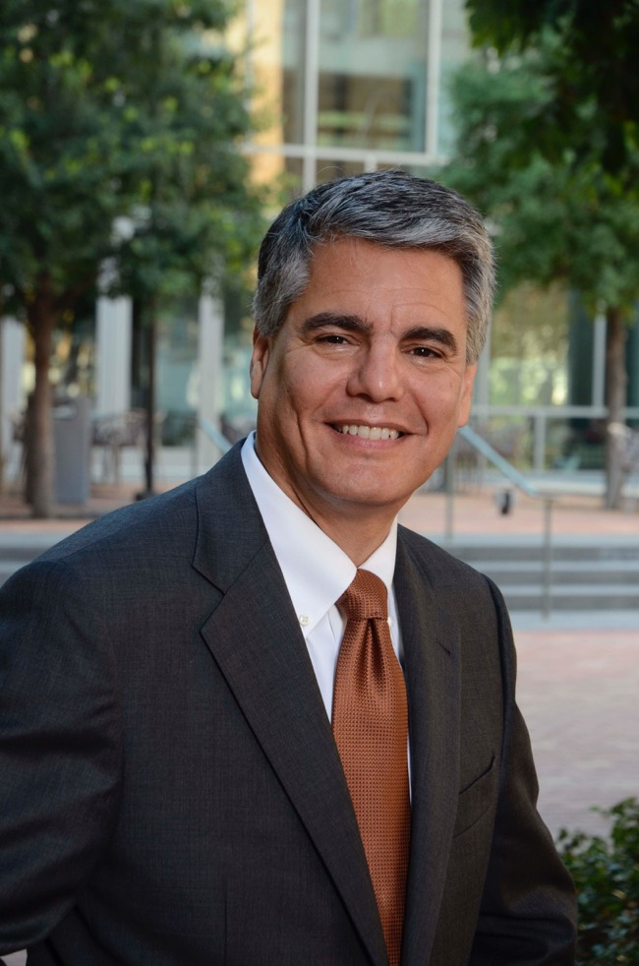
Communication with the President
Comments
Retrenchment policy update
Task force on signage
SB 212

Slide 7
Questions to the President
From Stuart Reichler, Associate Professor of Practice, Urban Ecosystems - Freshman Research Initiative:
Workday has been UT Austin's HR system for about one year. Yet instead of improvements, the hiring process has become demonstrably worse. This year in the College of Natural Sciences, we started the hiring process for our student employees in early August, yet over a week into the fiscal year, many of my employees have not been hired (This is the first time that this has happened in fourteen years of hiring student employees.). Furthermore, several of my employees have had to wait for over two hours to have their I-9 paperwork processed. Workday is costing the University millions of dollars in lost productivity and additional staff hours to resolve these issues. Are there any performance goals in our contract with Workday? What is the plan for resolving these ongoing issues with Workday? Are there a timeline and performance goals for Workday to include the functionality that UT Austin needs?

Slide 8
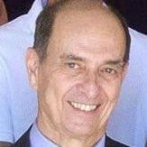
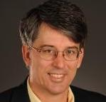
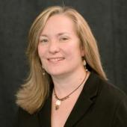
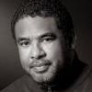
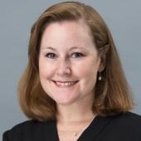
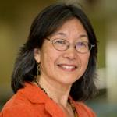
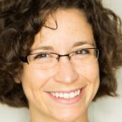
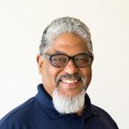
FACULTY COUNCIL EXECUTIVE COMMITTEE
Brian L. Evans
Faculty Council Chair (2019-2020) Professor, Department of Electrical and Computer Engineering
Alan W. Friedman
Secretary of the Faculty Council (2016-present) Professor, English
Charlotte Canning
Faculty Council Past Chair (2019-2020) Professor, Department of Theatre and Dance
Anthony L. Brown
Faculty Council Chair Elect (2019-2020) Professor, Department of Curriculum and Instruction
Catherine E. Weaver
Chair of the Graduate Assembly (2019-2020) Associate Professor, LBJ School of Public Affairs
Rowena Fong
Professor, School of Social Work
Amanda Hager
Associate Professor of Instruction, Department of Mathematics
John A. Yancey
Professor, Department of Art and Art History

Slide 9
Administrators Who Meet with the FCEC
Gregory Fenves, President
James Davis, Vice President for Legal Affairs
Mark J. T. Smith, Dean of the Graduate School and Senior Vice Provost for Academic Affairs
Maurie McInnis, Executive Vice President and Provost
Tasha Beretvas, Senior Vice Provost for Faculty Affairs
Rose Martinelli, Chief of Staff, Provost Office
Carlos Martinez, Chief of Staff, President’s Office

Slide 11
Faculty Council Oversight
Faculty Council
Evaluates, monitors, and recommends on undergraduate curriculums & degree programs
Develops, updates, and recommends on a wide array of University policies and procedures for students, staff and faculty
University policies and procedures include those governing
Faculty evaluations: promotion, tenure, annual, comprehensive, and mid-probationary
Faculty workload, compensation, academic freedom, and grievances
Student services, activities, admissions, financial aid, and employment
Budgets, libraries, research, IT, international studies

Slide 12
Report of the Chair Elect, Professor Anthony L. Brown

Slide 13
Today’s Guest Presenters
Senate Bill 212, Title IX Reporting—Leo Barnes (Chief Compliance Officer).
Voices Against Violence Program: Prevention and Clinical Services— Marla Craig (Senior Associate Director for Clinical Services, CMHC), Katy Redd (Associate Director for Prevention, CMHC), and Bree Van Ness (Peer Advocacy Coordinator).
BeVocal, Bystander Intervention—Steven J. Lundy (Project Manager and Lecturer, College of Liberal Arts) and Katy Redd (Associate Director for Prevention, CMHC).
SHIFT Program—Susan R. Hochman (Associate Director, University Health Center and CMHC), Brent Iverson (Dean, Undergraduate Studies), Kate Lower (Director, SHIFT Program), and Lori K. Holleran Steiker (Associate Dean of Undergraduate Studies).
https://cmhc.utexas.edu/vav/index.html

Slide 14
Senate Bill 212, Title IX Reporting
Leo Barnes, Chief Compliance Officer

Slide 15
Prevention and Clinical Services
Marla Craig, Senior Associate Director for Clinical Services, CMHC
Katy Redd, Associate Director for Prevention, CMHC
Bree Van Ness, Peer Advocacy Coordinator

Slide 16
Notes:
History:
UT Wellness Network committee- started in 2012
Stakeholders came together, organic growth from committee overtime
Since has evolved into a multi-level initiative, with full time and part time staff support

Slide 17
BeVocal Vision
BeVocal envisions a community that engages and invests in everyone’s safety and well-being.
BeVocal Mission
BeVocal enhances bystanders’ confidence and motivation to intervene in order to prevent and reduce harm.
Notes:
BeVocal’s vision is that it envisions a community that engages and invests in everyone’s safety and well-being.
BeVocal’s mission is to enhance bystanders’ confidence and motivation to intervene in order to prevent and reduce harm.
Help BeVocal infuse bystander intervention across UT Austin by partnering with as many campus entities as possible

Slide 18
BeVocal’s Steps to Intervention
1. Recognize Potential Harm
2. Choose to Respond
3. Take Action
Definition
Bystander intervention is recognizing a potentially harmful situation or interaction and choosing to respond in a way that could positively influence the outcome.
Notes:
Definition: Bystander intervention is recognizing a potentially harmful situation or interaction and choosing to respond in a way that could positively influence the outcome.
It is one of the few research backed and evidence-informed ways that has showed to be effective in curbing and preventing sexual assaults and other forms of harm.
BeVocal is designed to address multiple types of harm and enhance an individual’s confidence to intervene. The BeVocal initiative seeks to promote intervention as a norm of our community and in turn change the campus culture.
Often when people think of moments of harm, they imagine or reflect on when high-risk behavior, such as a physical assault, alcohol poisoning, or a hate crime occurring.
We ask that participants in BeVocal trainings and workshops “zoom out” to look at the culture that enables harm to occur in the first place.
This means holding each other accountable for our language and subtle actions that either create a culture of safety and inclusivity or one that may be alienating, oppressive, or otherwise stressful.
In our workshops and trainings, we dive deeper into each of the steps – Recognize. Choose. Act.
Taking action can mean a lot of things, whether it be directly confronting the situation or indirectly helping by getting other people involved, there is no one way to intervene and no hierarchy of forms of action. The important thing is that you assess the situation, consider your safety, and take action.
There is a lot of research out there on the impact of various forms of harm, which could be in the form of bullying, harassment, assault and more. And the impact is serious, and that’s why this work is so important. Harm can lead to:
Psychological impacts such as trauma, depression, anxiety, and PTSD, depending on the severity of the incident
Behavioral impacts such as limiting mobility, people choosing not to go out at a certain time or to a certain location
Missing work or school, or even leaving a job and transferring schools
It really affects the quality of our lives, in our neighborhoods and our communities

Slide 19
BeVocal Structure & Projects
Executive Board
Faculty Advisory Board
Student Engagement
Infusion of messaging across campus
Partnerships
Co-branding
Workshops & events
Train the trainer model

Slide 20
Faculty Engagement & BeVocal
Spring 2018: Faculty Advisory Board Created
Representation
Projects:
Faculty workshops
Informal interviews to inform work
Online Resource Development
Videos with key stakeholders
Notes:
Earlier this year, we wanted to find out from faculty what their experiences around harm and bystander intervention has been, and what they would want to see if there was expansion …

Slide 21
White Paper: BeVocal in Faculty Contexts
Leadership & administrative policy
Mentorship & faculty Culture
Curriculum and the classroom
Shifting from Recognition to Choosing to Act (call to action)
Notes:
Overview of themes developing through the videos and preliminary work.
Hope to debut at FIC Symposium in November

Slide 22
Contact us:
bevocal@austin.utexas.edu
Website:
https://wellnessnetwork.utexas.edu/BeVocal

Slide 24
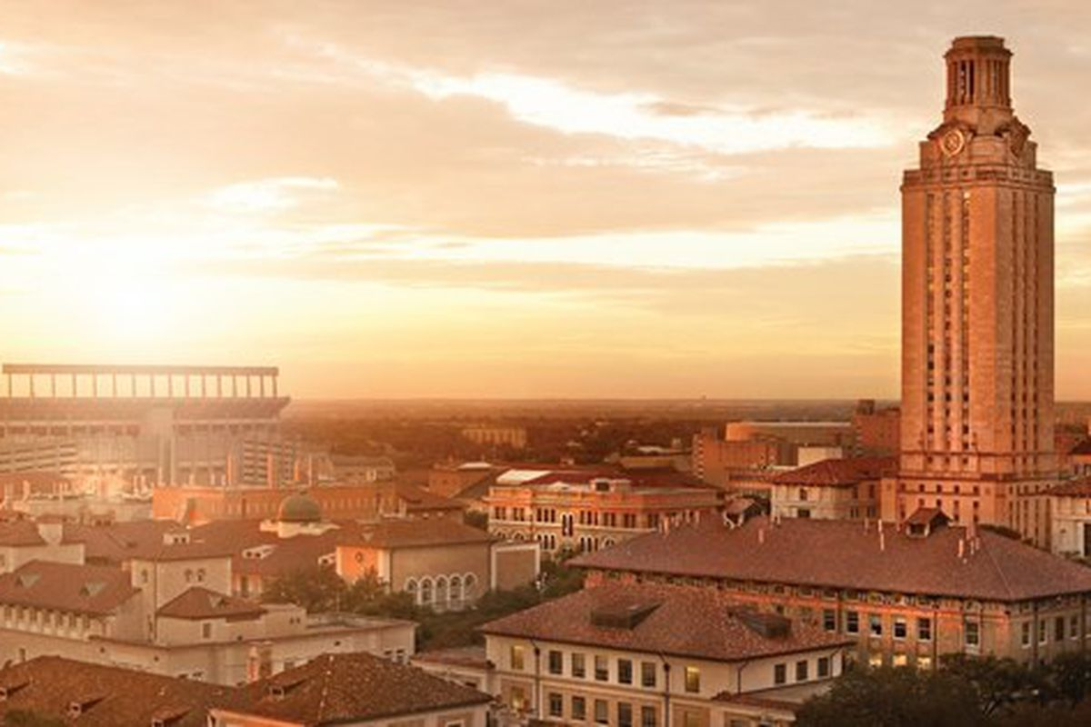
Bold call to action:
Shifting the existing norms around substance use at UT Austin.

Slide 25
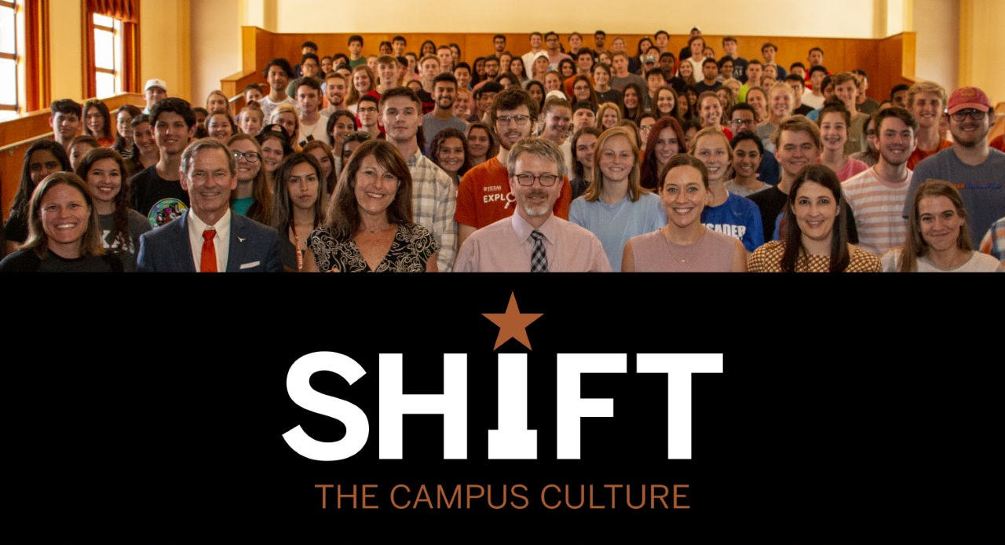

Slide 26
SHIFT
Comprised of 6 pilot initiatives
Leverages existing programs, while cultivating further innovation
Unique synthesis between Academics (UGS) and Student Affairs
Faculty play key role in foundation of SHIFT; Approximately 30 Signature Course Professors have already integrated SHIFT content into courses

Slide 27
SHIFTing the Campus Culture
Classroom
Environment
Events
Conversation
Communication
SHIFTovation

Slide 28
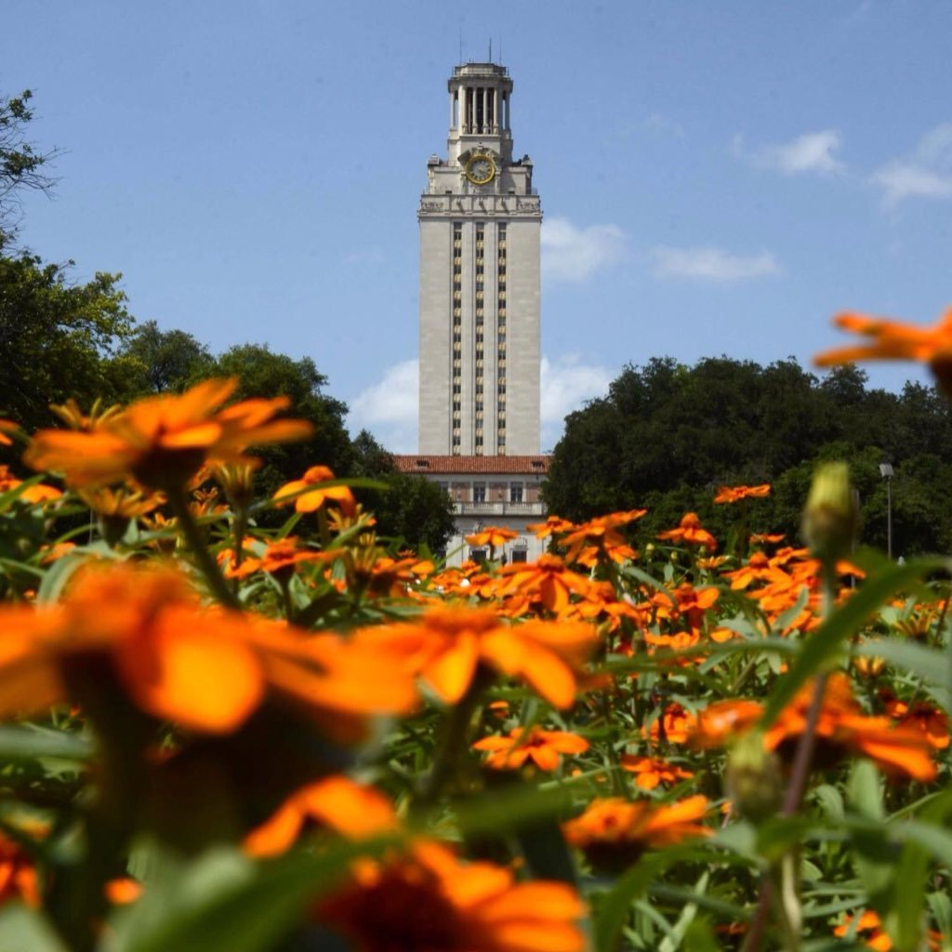
Join the conversation. SHIFT the culture.
SHIFT Launch Celebration: September 24th, 11am-2pm
Contact SHIFT:
kate.lower@Austin.utexas.edu
512.475.8437
SSB G.1.400HA
@utshift

Slide 29
Announcements
The State of the University Address will be held on September 18 at 3:00 pm in the B. Iden Payne Theatre in the Winship Drama Building.
Civitatis Award nominations due in the Office of the General Faculty by October 14th.
Faculty Council members’ Grievance Hearing Pool representatives due in the Office of the General Faculty.
The annual meeting of the General Faculty will be held on October 14th at 2:15 pm in Main 212 and will be immediately followed by the second meeting of the Faculty Council.

