Slide 1
Can we talk? Learner Engagement and Cooperation Online
Webinar team
Patricia Kyle, Coordinator for languages online, LAITS and Department of French and Italian, patricia.kyle@austin.utexas.edu
Amanda Bush, Lecturer and Language Program Coordinator, Italian, Department of French and Italian
Vanessa Fanelli, PhD Candidate, Italian, Department of French and Italian
Yazz Fawaz, Lecturer, Department of French and Italian, yazzfawaz@utexas.edu
Vivian Flanzer, Senior Lecturer, Portuguese, Department of Spanish and Portuguese
Maxence Leconte, Lecturer, LAITS & Department of French and Italian
mpl642@utexas.edu

Slide 2
Webinar Objectives
Participants will find out how to adopt a Community of Inquiry framework for promoting student engagement.
Participants will find out how to use Canvas tools, Zoom features, and more to facilitate interpersonal communication in peer-to-peer and class discussion tasks.
Participants will find out how to construct a supportive online learning community in which students feel safe to share meaning and take risks.
Participants will find out how to weave together human and technological elements to create a positive affective environment that is both fun and motivating.

Slide 3
POLL 1 Student engagement

Slide 4
Webinar organization
1
Introduction
6
Wrap-up
5
Questions and Answers
4
Language tasks for interpersonal communication
3
Tech tools for creating communicative tasks
2
A “Community of Inquiry” model for engaging students

Slide 5
POLL 2 Community of Inquiry

Slide 6
Webinar organization
1
Introduction
6
Wrap-up
5
Questions and Answers
4
Language tasks for interpersonal communication
3
Tech tools for creating communicative tasks
2
A “Community of Inquiry” model for engaging students

Slide 7
A Community of Inquiry (COI) Model
What is it?
Why is it important?
How do we use it?
What are some technology tips & tricks?

Slide 8
Components of a Community of Inquiry Framework
Teaching Presence
Course design and content
Course facilitation
Implementation of tasks and assessments
Social Presence
Open communication
Affective expression
Group cohesion
Cognitive Presence
Construction and confirmation of meaning
Sustained reflection and discourse

Slide 9
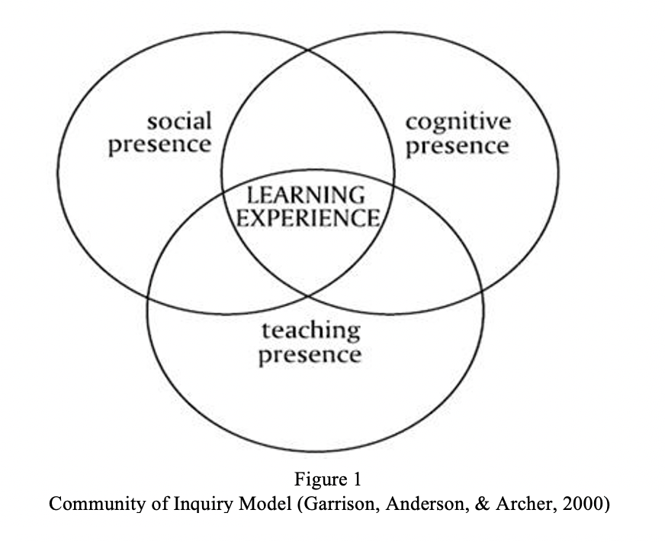
Intersection of teaching, social, and cognitive presence

Slide 10
Teaching Presence
Use an icebreaker to start class, consider including a poll to stimulate quick interaction.
Create an introductory video of yourself that provides some personal information (e.g., your pets, hobbies, favorite books or music).
Be present on discussion boards, via announcements, email, and virtual office hours.
Let students know how and when they can reach you.
Show up 10-15 minutes early for class.
Encourage, acknowledge, and reinforce student contributions.
Provide timely, supportive, and actionable feedback.
Provide clear, explicit, redundant instructions with models for all course tasks.

Slide 11
Social Presence
Create a list of course rules for acceptable behaviors, also known as “netiquette.”
Have students post photos, introductory videos or audio recordings on discussion boards.
Create tasks that allow students to align learning with their personal interests.
Build learner choice, flexibility, and control into the tasks you create.
Encourage or require participation in class discussions.
Use team-based, collaborative, & problem-solving tasks.
Encourage real-time communication via the chat or shared whiteboard.
Share stories with students and encourage students to share their stories.

Slide 12
Cognitive Presence
Use backward design to articulate what students will learn.
Use a variety of different types of content and task, e.g., audio, video, print, infographic documents and reflections, games, other team-based tasks.
Provide frequent low-stakes formative assessments.
Encourage students to reflect on what they are learning and to link that to their own lives.
Provide peer-review opportunities.
Encourage multiple perspectives, dialogue, divergent thinking, experimentation, and risk-taking.
Connect current learning to previous learning.
Provide opportunities for students to gain insight into how others think and are thinking.

Slide 13
Technology Tips and Tricks
Provide audio and video recordings to give feedback, especially when you want to provide more in-depth explanation of a concept or structure or model pronunciation.
Use teleconferencing, screen casting, and video editing tools, and QuickTime video tools to create icebreakers, make introductory videos, and provide feedback.
Select appropriate applications for students to use for performing collaborative language learning tasks such as Panopto video for making slide show recordings, Zoom for peer-to-peer teleconferencing, and Piazza for interacting outside of class.

Slide 14
Webinar organization
1
Introduction
6
Wrap-up
5
Questions and Answers
4
Language tasks for interpersonal communication
3
Tech tools for creating communicative tasks
2
A “Community of Inquiry” model for engaging students

Slide 15
POLL 3 Technology tools

Slide 16
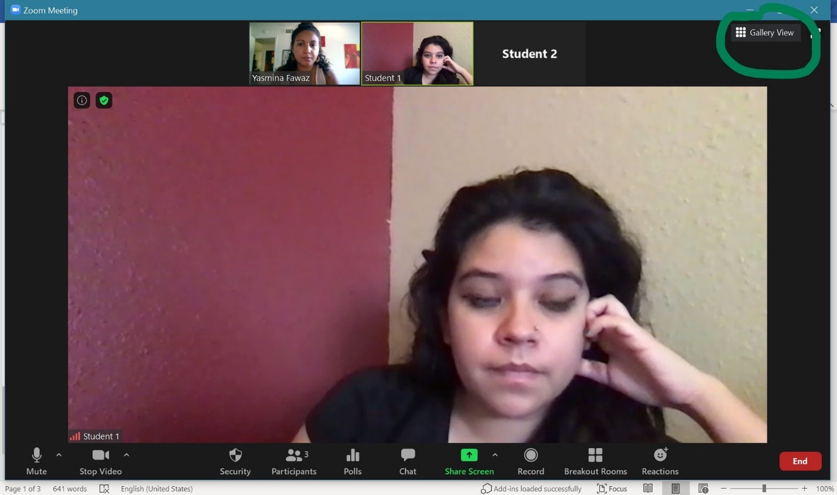
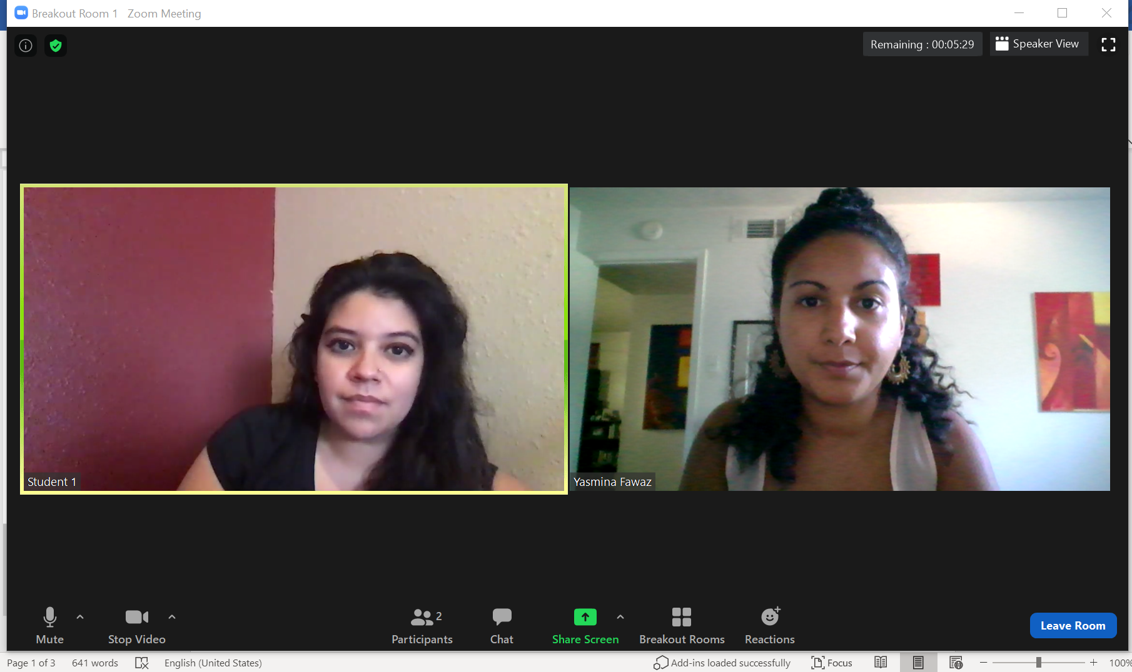
Speaker view and Gallery view

Slide 17
Profile picture

Slide 18
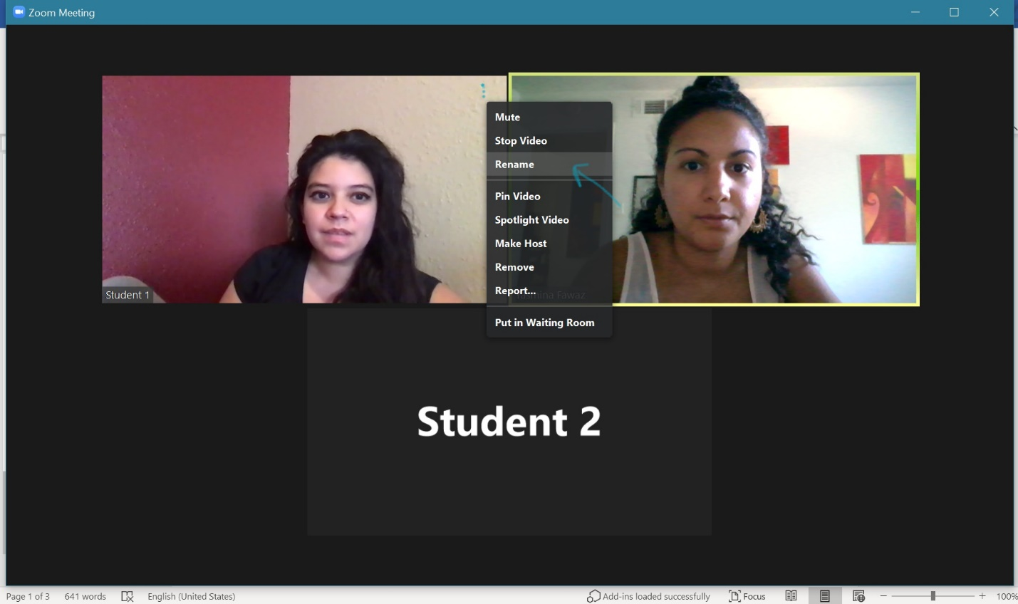
Renaming feature, once enabled

Slide 19
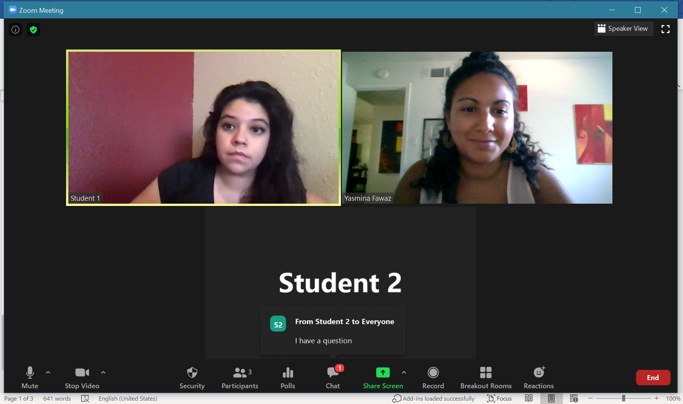
Features on the Zoom dashboard – polls, chat, breakout rooms, share screen

Slide 20
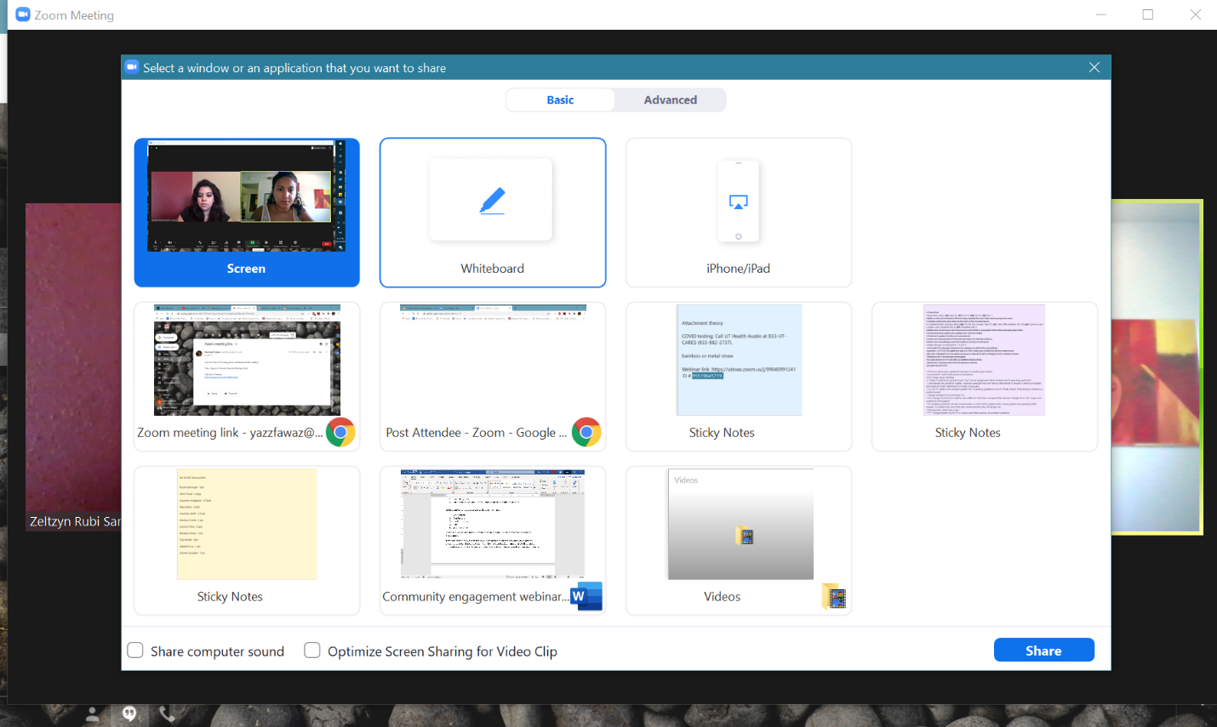
White board

Slide 21
Webinar organization
1
Introduction
6
Wrap-up
5
Questions and Answers
4
Language tasks for interpersonal communication
3
Tech tools for creating communicative tasks
2
A “Community of Inquiry” model for engaging students

Slide 22
POLL 4 Interactive tasks

Slide 23
Webinar organization
1
Introduction
6
Wrap-up
5
Questions and Answers
4
Language tasks for interpersonal communication
3
Tech tools for creating communicative tasks
2
A “Community of Inquiry” model for engaging students

Slide 24
Questions?

Slide 25
Webinar organization
1
Introduction
6
Wrap-up
5
Questions and Answers
4
Language tasks for interpersonal communication
3
Tech tools for creating communicative tasks
2
A “Community of Inquiry” model for engaging students

Slide 26
Webinar Objectives
Participants will find out how to adopt a Community of Inquiry framework for promoting student engagement.
Participants will find out how to use Canvas tools, Zoom features, and more to facilitate interpersonal communication in peer-to-peer and class discussion tasks.
Participants will find out how to construct a supportive online learning community in which students feel safe to share meaning and take risks.
Participants will find out how to weave together human and technological elements to create a positive affective environment that is both fun and motivating.

Slide 27
POLL 5 Student engagement

Slide 28
Master the Media of Online Language Instruction
LAITS / TLC Web Event Series for Fall 2020
NOVEMBER
TLC – When Zoom is Over: Creating Language Materials for Asynchronous Interaction
Thursday, November 5, 4-5:30 pm
LAITS – Why stop there? Continuing Virtual
Communication Outside of Class
Thursday, November 12, 4-5:30 pm
Panopto video
Videoconferencing
Discussion boards
Writing and peer review

Slide 29
Please contact us for additional support
Patricia J Kyle, LAITS & French and Italian, patricia.kyle@austin.utexas.edu
Yazz Fawaz, French and Italian, yazzfawaz@utexas.edu
Maxence Leconte, LAITS & French and Italian, mpl642@utexas.edu

Slide 30
Thank you for your participating in today’s webinar.

