Slide 1
SOPI: Past and Present
Dale Koike
University of Texas at Austin
d.koike@Austin.utexas.edu
Texas Language Center Workshop
July 11, 2020

Slide 2
Outline
The ‘proficiency’ construct
The development of the ACTFL Guidelines and the OPI
The SOPI, history, how structured/functions, criticsms
My own SOPI, example, grading rubric
(If time) SPT website (expectations of levels); HL proficiencies

Slide 3
What is ‘proficiency’?
“To be competent or skilled at doing or using something” (www.dictionary.com).
In L2 learning, to perform functions through the L2

Slide 4
Focus on Oral Proficiency
Audiolingual and communicative competence efforts (1960s and 1970s) (Brown Mitchell & Ellingson Vidal 2001, Omaggio Hadley 2001)
American Council on the Teaching of Foreign Languages (ACTFL) Proficiency Guidelines (1986, 1999, 2012).
ACTFL Proficiency Guidelines: to provide descriptions of linguistic and nonlinguistic features of a learner’s communicative ability when speaking, writing, listening, and reading in the L2.
Levels of novice, intermediate, advanced, superior, and distinguished
sublevels within the novice, intermediate, and advanced levels.

Slide 5
Proficiency levels
Other descriptions of learner proficiency levels
Interagency Linguistic Roundtable (ILR) Proficiency scale
CEFR scale in Europe
Scales to describe theorized developmental steps, provide benchmarks for learners > become a cornerstone for assessments
Some positive impacts: language programs and classes became more learner-centered, communicatively-centered, and function-focused from a linguistic and communication perspective (Liskin-Gasparro 2003).

Slide 6
Simulated Oral Proficiency Interviews (SOPI)
Emulate the OPI as much as possible; tape-recorded format (not face-to-face) (Stansfield 1996).
Elicits speaking via written or oral prompt, then recorded in some way
Prompts
Objective of the four qualities of a good test: authenticity, reliability, validity, and interactiveness (Bachman & Palmer 1990; ).

Slide 7
Format of prototypical SOPI
1. Brief personal questions as warm-up
2. Then performance-based tasks to elicit language ("level check" and "probe" phases of OPI)
3. Pause/tone; candidate then records each answer (e.g., 7 seconds), then cut off with another tone
>Assess ability to perform various functions of different levels (Intermediate, Advanced, and Superior) of the ACTFL Proficiency Guidelines.

Slide 8
Format of prototypical SOPI
4. Picture-based tasks: questions about pictures; give directions with map; describe a particular place in a drawing; narrate in the present, past, or future
Higher levels of the Guidelines: e.g., stating advantages and disadvantages, supporting an opinion, apologizing, giving an informal talk
Lower proficiency candidates stop where abilities do not meet needs of task
Possible ‘wind-down’

Slide 9
Scores; advantages
5. Scores: from Novice to Superior/Distinguished
Advantages: any teacher or administrator can administer the SOPI because it is recorded
Claim increased validity and reliability over the OPI; standardized format that is used uniformly
Save time and costs
Provides assessment quickly

Slide 10
My SOPI at UT (“RAACS”; now defunct)
Modeled after TOPT (now part of TEKS for LOTE)
TOPT required monologic answers of 60-90 seconds in length
Students read a prompt, got 1 minute to prepare an answer, and then taped it onto a tape cassette in the language lab.
Now: course management system (Canvas); students do everything online, within a given time limit
Students can record themselves at home; camera
Students do not know the questions beforehand

Slide 11
Sample clip from SOPI (Koike)

Slide 12
Study on SOPI (vs. OPI)
Particular question had more effect than the type of test modality (OPI vs. SOPI) itself
Test type did influence the particular strategies and type of discourse in answers
OPI: reflected interactive nature (features of dialogue)
SOPI: a more formal and at times awkward discourse (e.g., more fillers to fill in gaps; self-correction)
SOPI: tended to stay more on task; more ideas with better organization
Suggestion: proficiency test should examine ability in both monologic (SOPI-like) and dialogic (OPI-like) contexts

Slide 15
Caveats
Not conversations but rather interviews (one person controls, the other responds, lack of true co-construction of meaning)
Young & He (1998) on ‘interactiveness’: way candidate draws on different types of knowledge :
Knowledge of the L2, how to overcome communication difficulties (strategic competence), how to organize and plan a task (metacognitive strategies);
Knowledge of topic, and emotions to particular tasks and topics (affective schemata).
These all enter into answers; should be acknowledged in some way in the ratings.

Slide 16
Assessment
My conversation classes: evaluation (grade) based on ‘portfolio’ of recordings and videos of different types of talk,
with people of different relationships, and of different topics
get an idea of their range and breadth of proficiency in different contexts and language functions.

Slide 17
Some idea of proficiency levels
Spanish Proficiency Training (SPT) website (http://www.laits.utexas.edu/spt/); free, online resource to train Spanish teachers and learners to work with proficiency levels
Help learners of Spanish understand concept of proficiency levels through practice in evaluating others and, potentially, themselves
Website: (1) provides necessary proficiency level training;
(2) free; and
(3) allows teachers to gain necessary training either as in-house training session or on own free time

Slide 18
Overview of the SPT website
Web-based corpus of 327 videos, 1-5 minutes each
38 L2 learners, including 16 Spanish heritage language learners
Interview format focused on learners
Interactive questions with feedback to assess features relevant to proficiency

Notes:
Now, I would like discuss the two principal purposes of the website: training and corpus research

Slide 19
Proficiency Levels
SPT level | ACTFL level | SPT Functions/Contexts
Beginner | Novice Low/Mid | Produce lists of words and phrases Communicate by repeating interlocutor’s words and with learned utterances
Beginner–Intermediate | Novice High | Sometimes but not consistently maintain simple conversation Communicate via a combination of learned utterances and spontaneous language
Intermediate | Intermediate Low/Mid | Consistently maintain simple conversation Produce sentences or strings of sentences
Intermediate–Advanced | Intermediate High | Sometimes but not consistently tell stories about past events Explain and describe in detail
Advanced | Advanced Low/ Mid | Tell stories about past events Express (and sometimes support) opinions on abstract issues Use communication strategies to compensate for gaps in linguistic knowledge
This chart is from the User’s Manual, created by Judith Liskin-Gasparro.
Notes:
Inspired by ACTFL

Slide 21
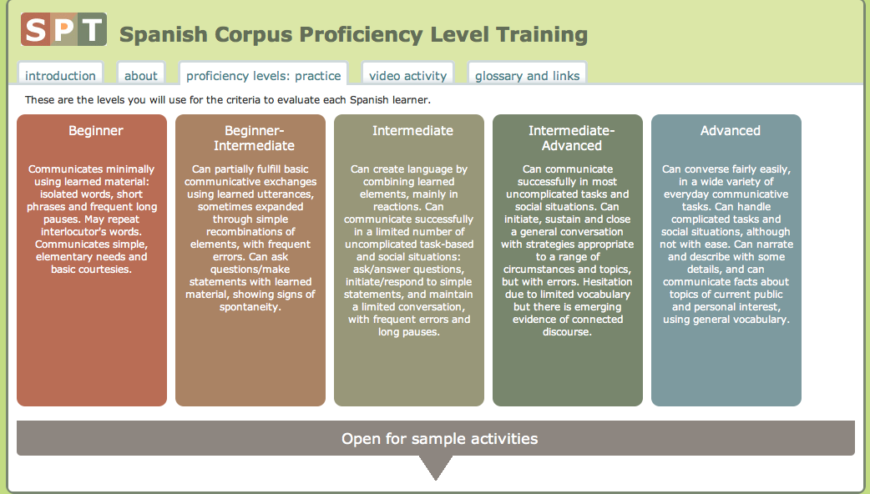

Slide 22
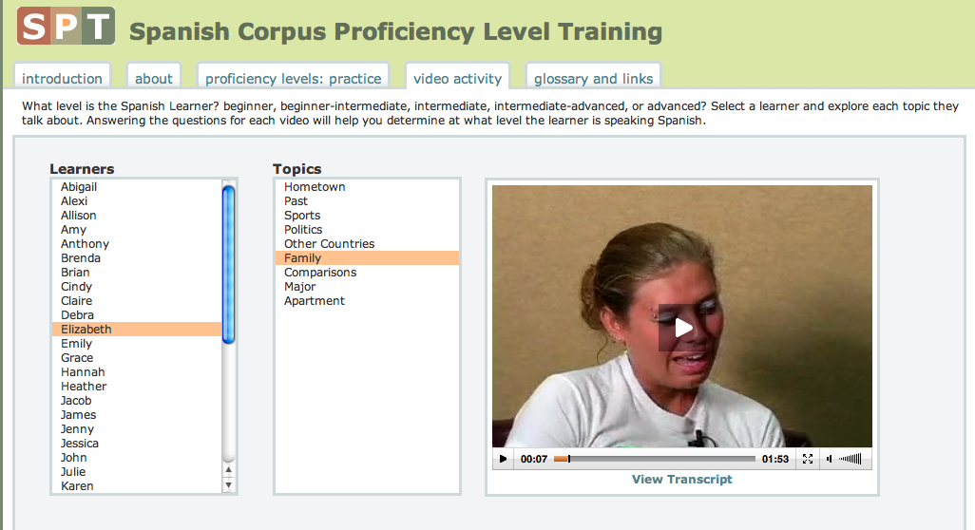
https://laits.utexas.edu/spt/video

Slide 23
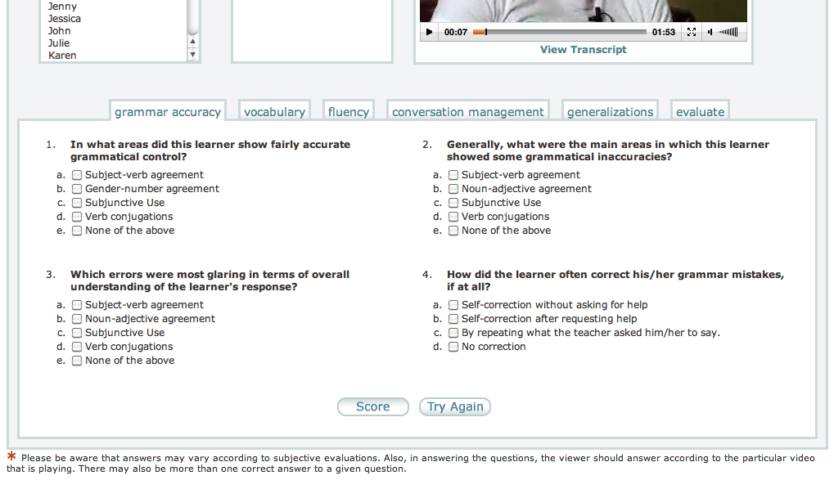

Slide 24
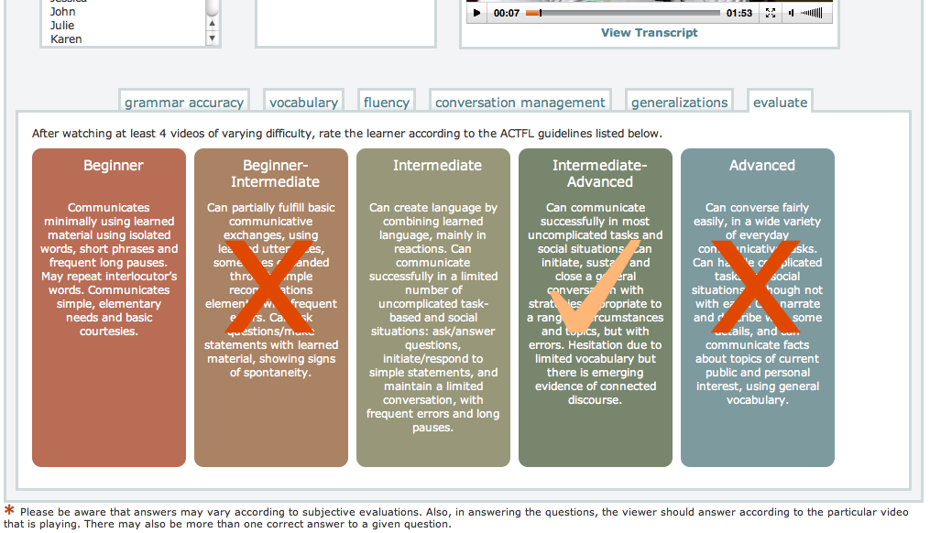

Slide 25
User’s Guide
Training – becoming familiar with the website and the proficiency level ratings
Video Activity – using the website to rate learners’ proficiency levels
Sample Activity 1: Developing Oral Proficiency in the Classroom
Sample Activity 2: Analyzing Preterit and Imperfect Distinction in Anecdotal Narrative

Slide 26
¡Gracias!
Questions?

